Slide 1

Art Contest
2023 - 2024

Slide 2
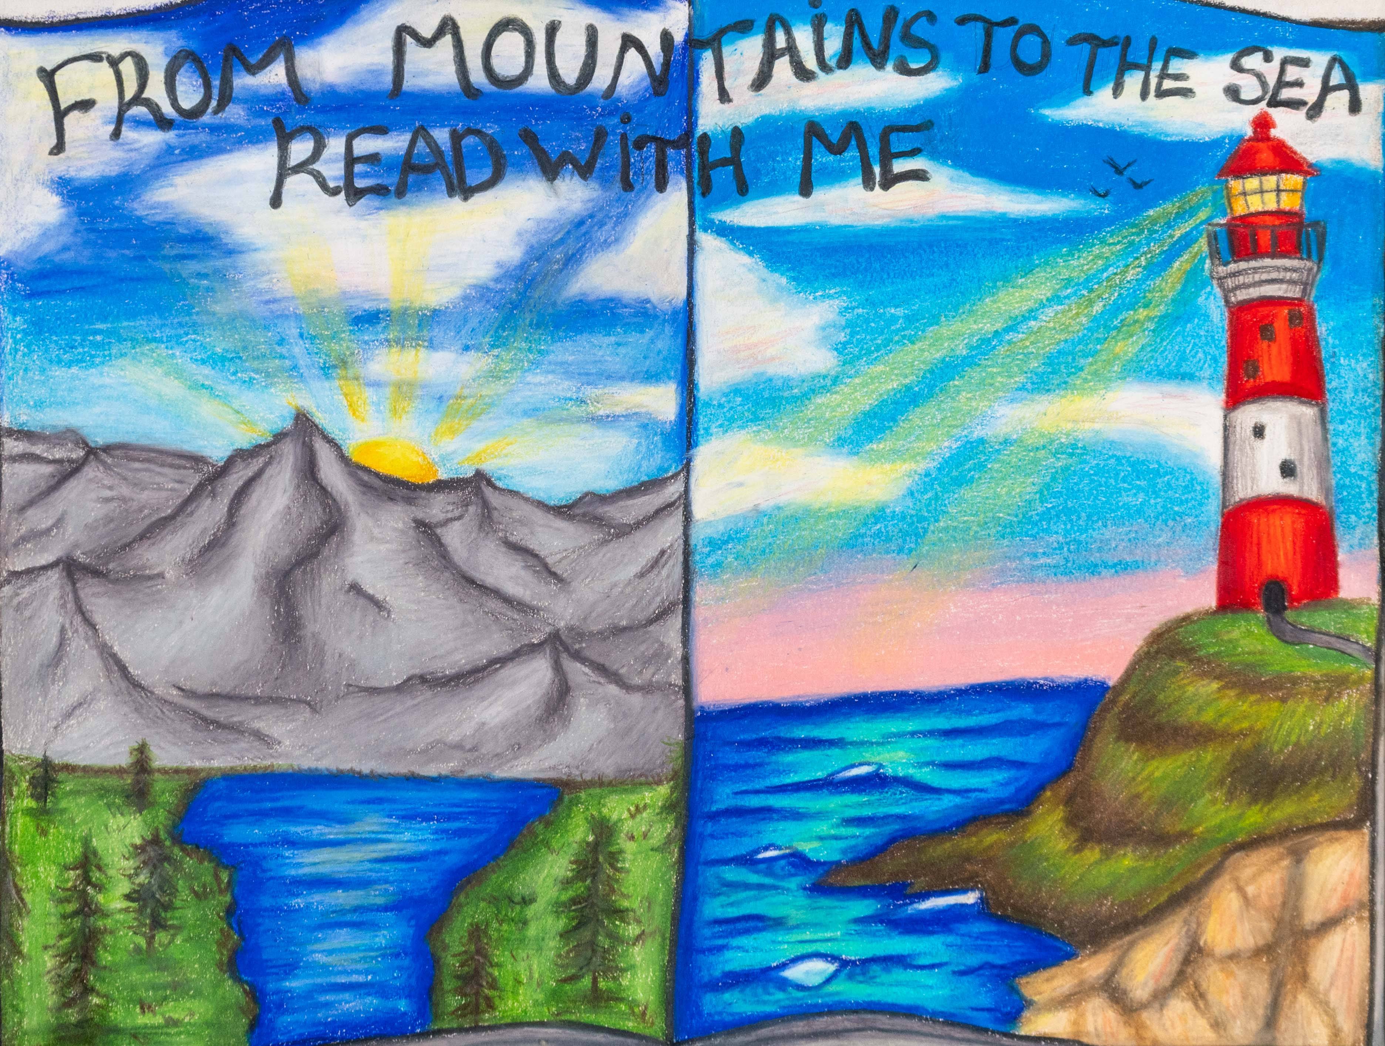
BEST IN SHOW
Amanda Paciotti
South Florence High School
Florence School District
Teacher: Mrs. Adrianna Gardner

Slide 3
Division 1
Grades K - 2

Slide 4

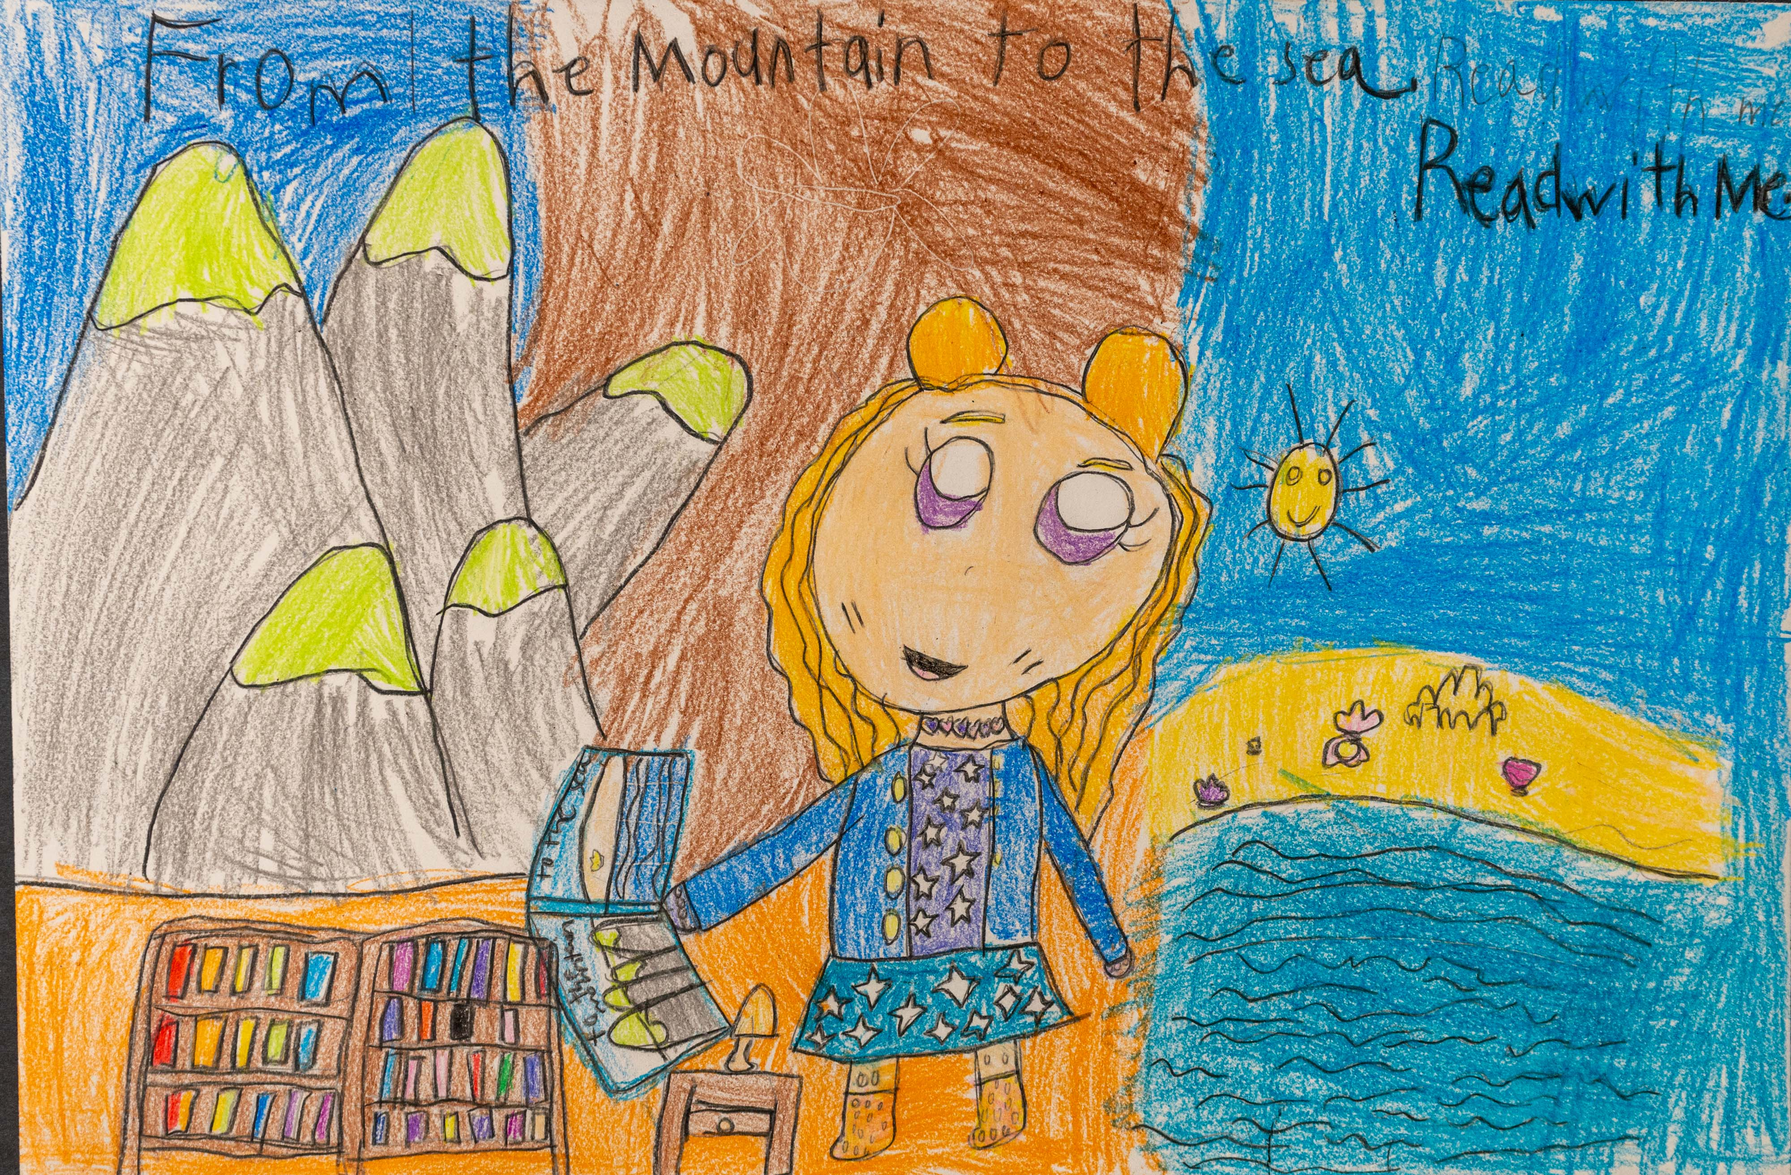
Honorable Mention
Lola Knight
Division 1: K-2nd Grade
Arden Elementary School
Richland County School District One
Teacher: George Sims

Slide 5
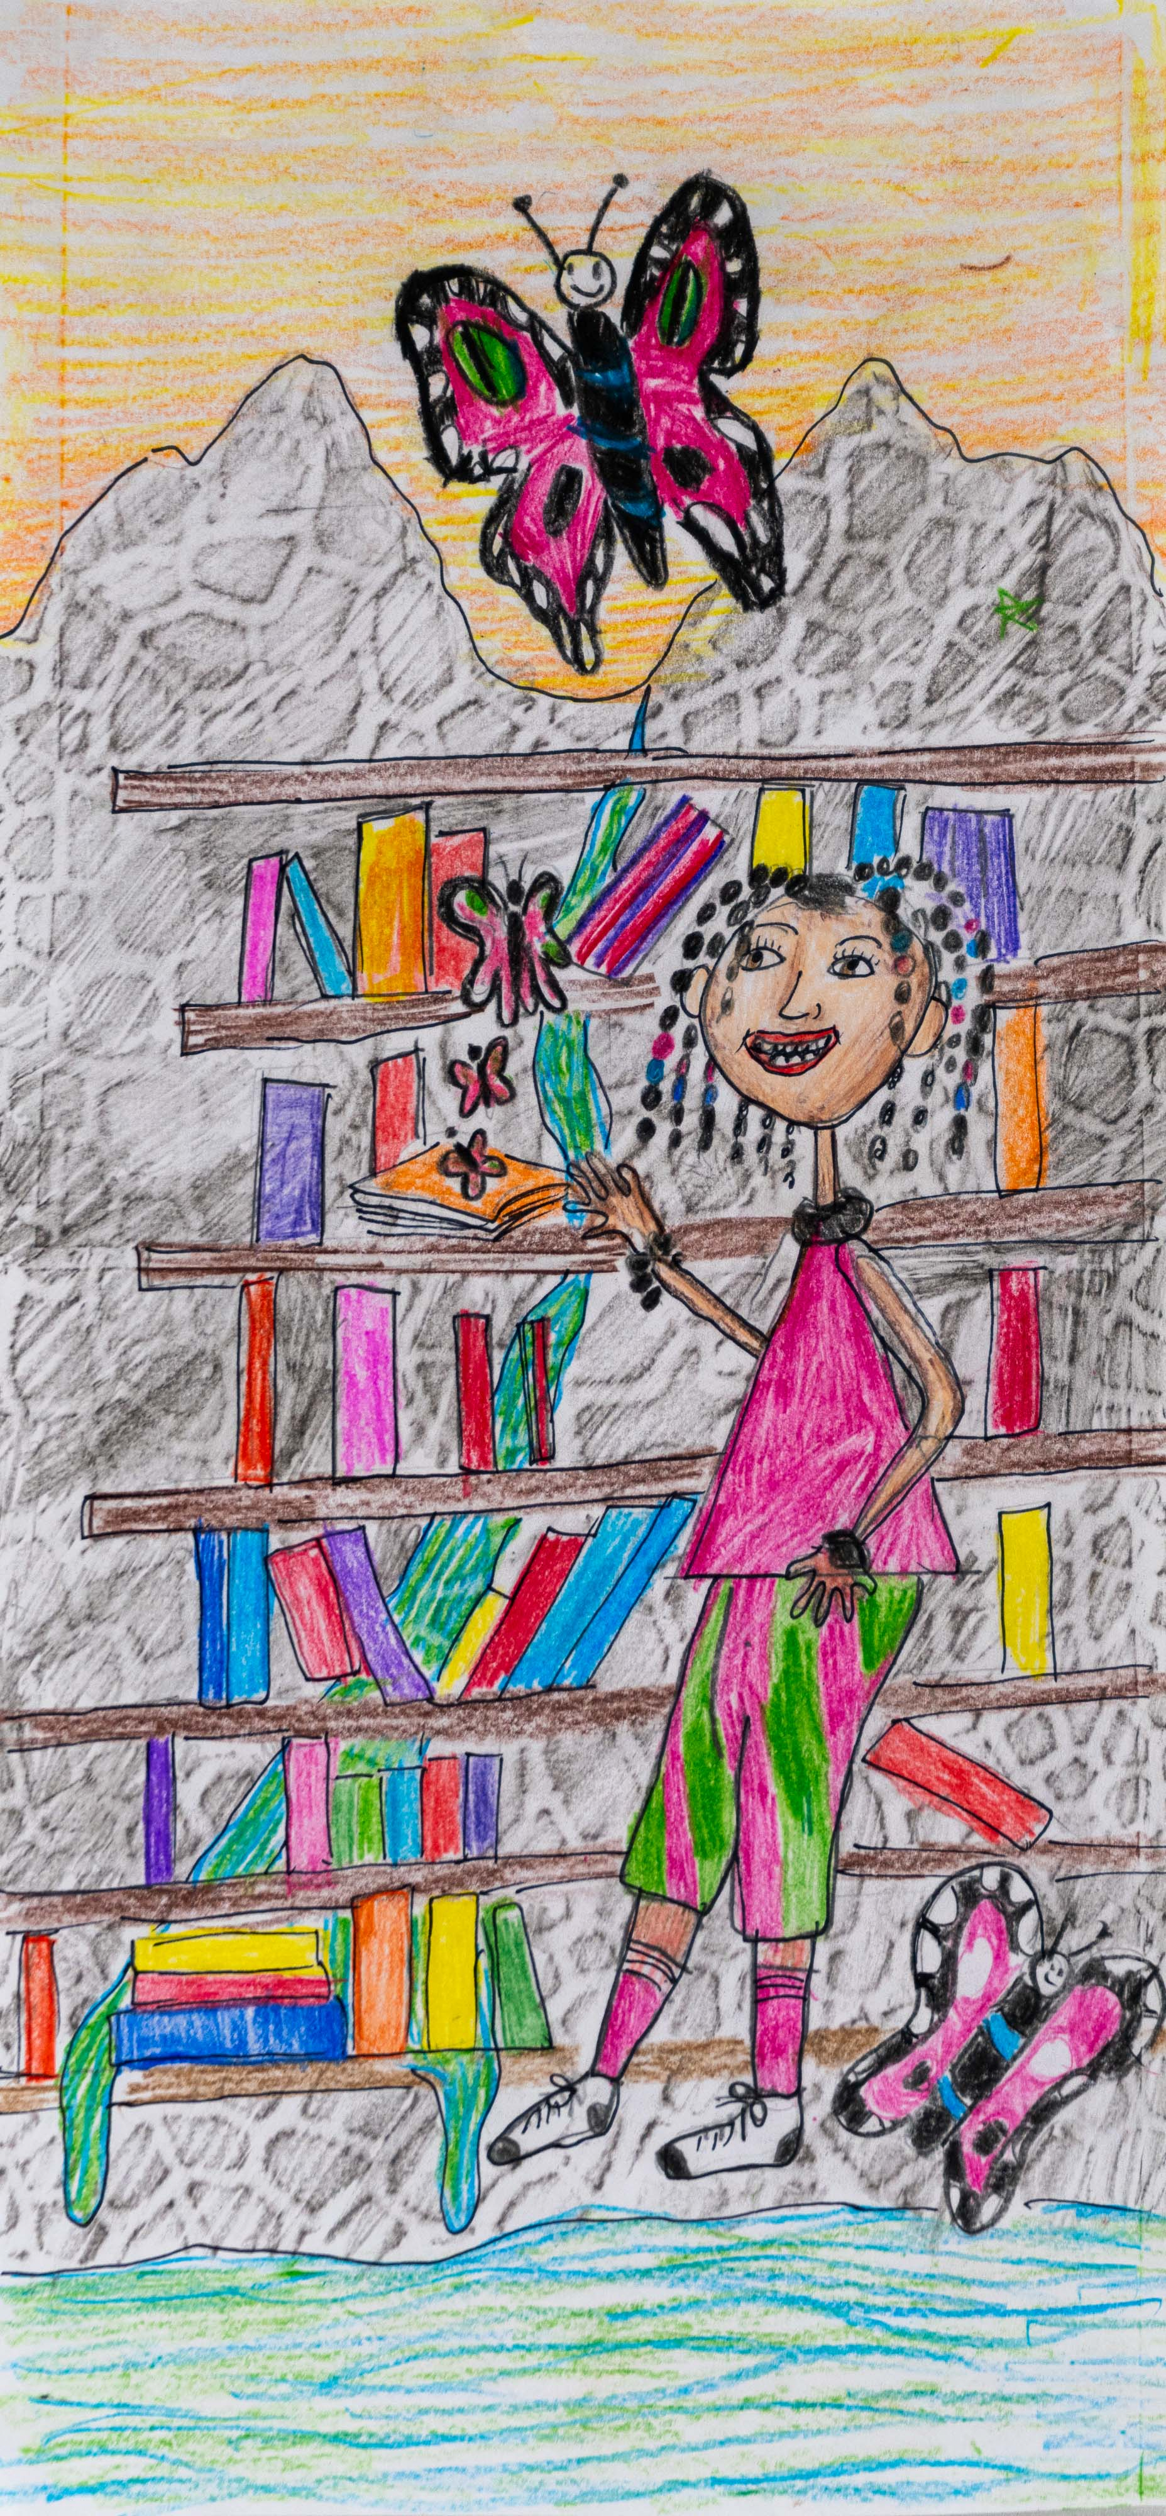
Honorable Mention
Kennedi Copeland
Division 1: K-2nd Grade
Fairfield Magnet School
for Math & Science
Fairfield School District
Teacher: Kimi Daly

Slide 6
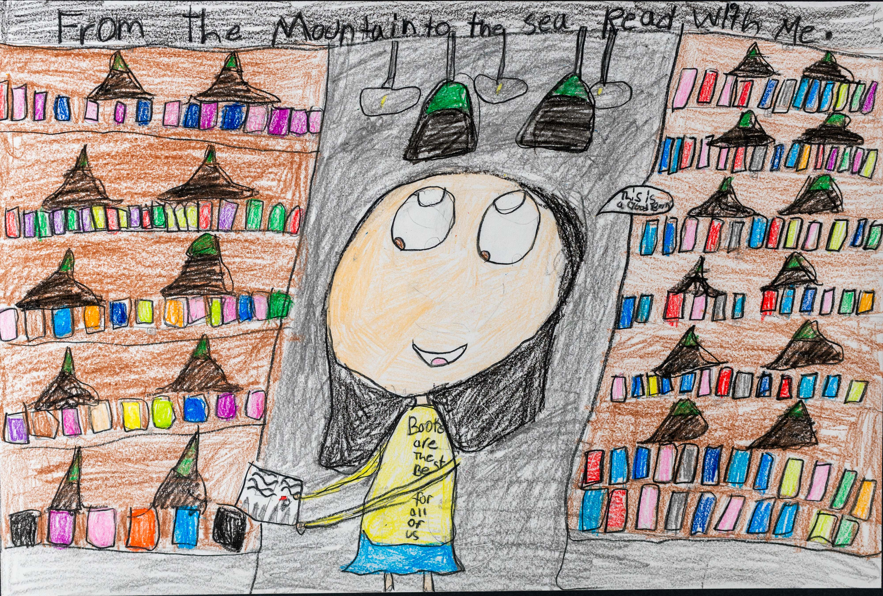
Honorable Mention
Emani McDonald
Division 1: K-2nd Grade
Arden Elementary
Richland County School District One
Teacher: George Sims

Slide 7
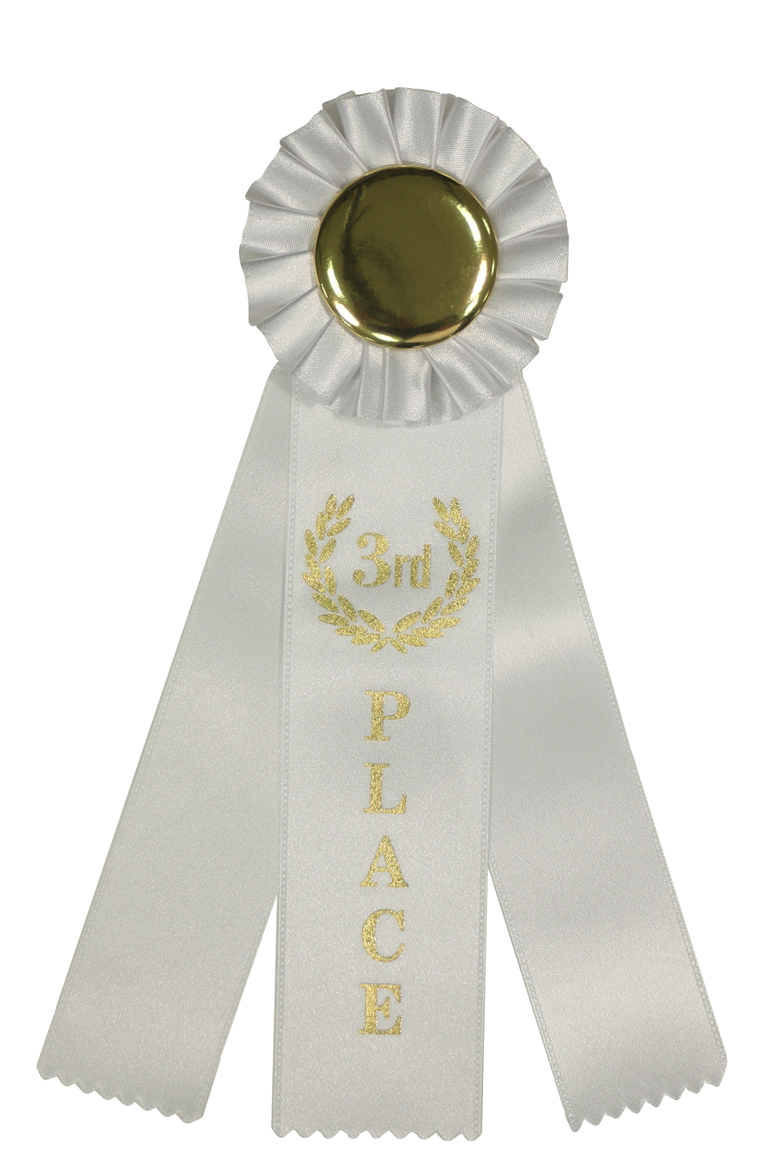
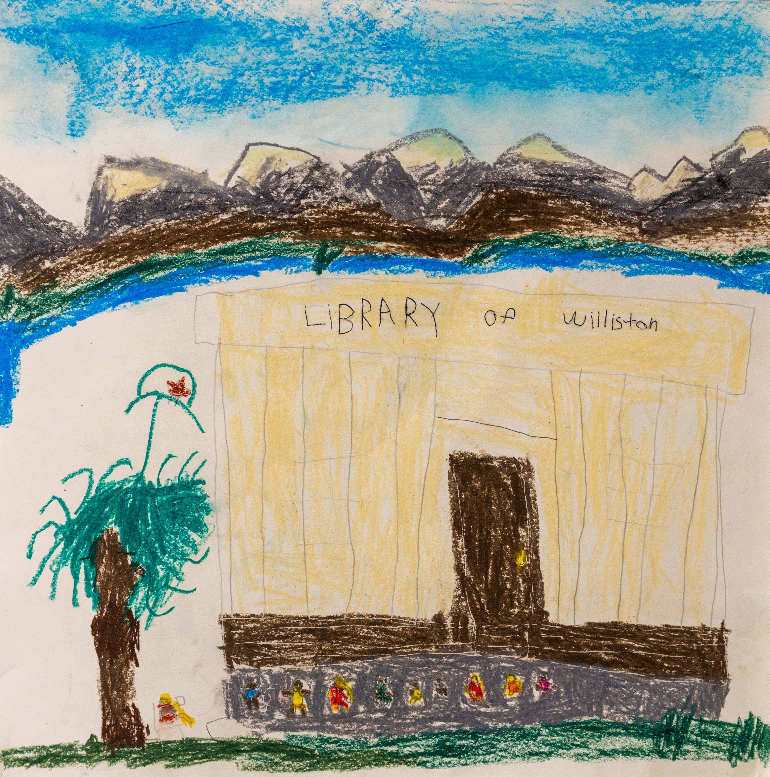
3rd Place Winner
Elijah Tishchenko
Division 1: K – 2nd Grade
Kelly Edwards Elementary School
Barnwell County Consolidated
School District
Teacher: Cassie Miranda Govan

Slide 8
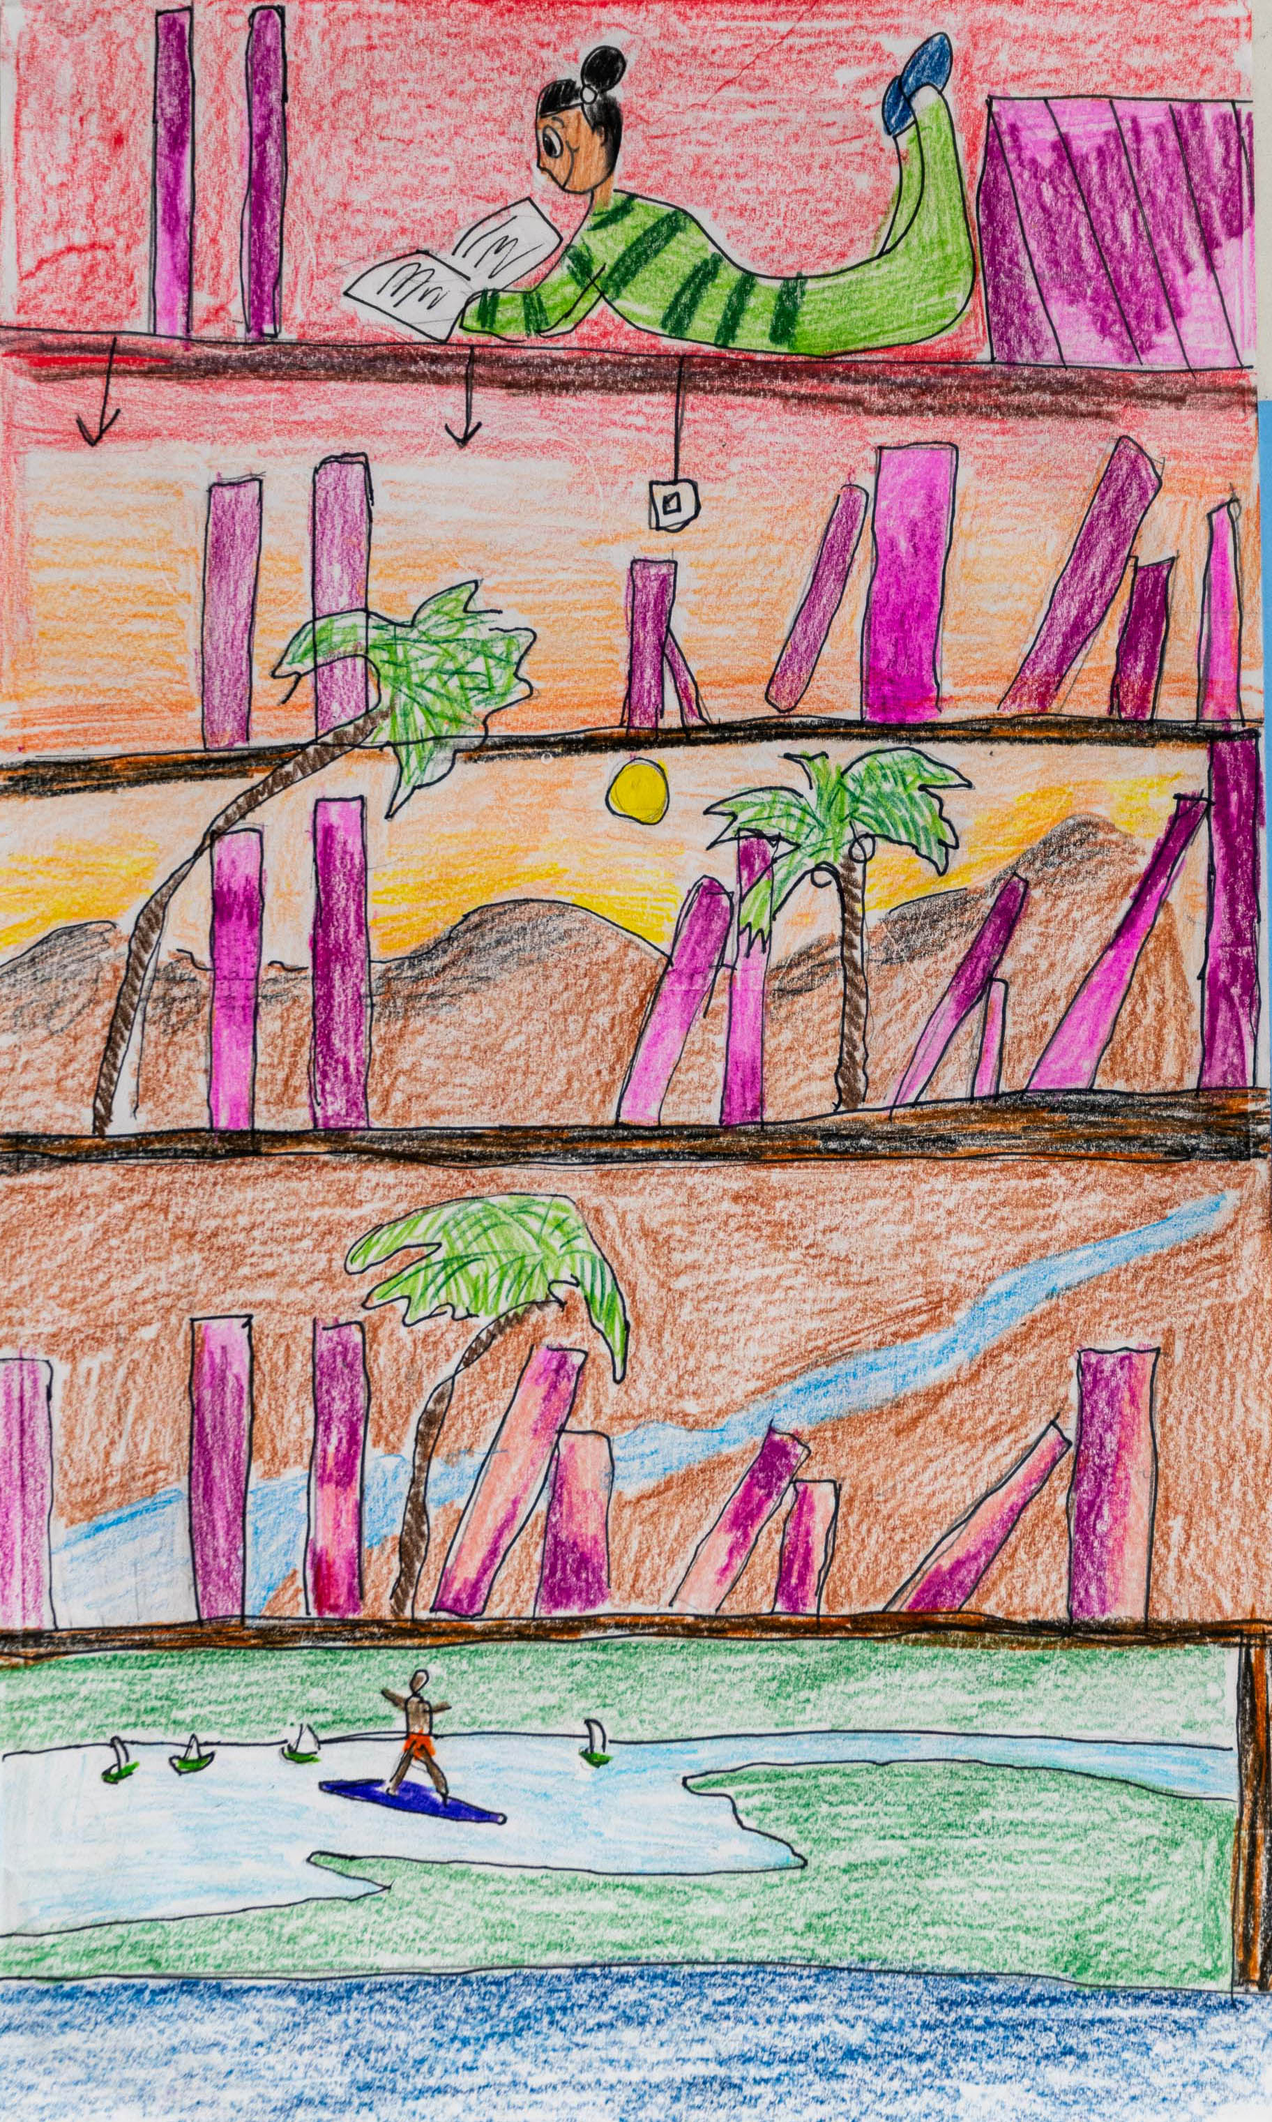

2nd Place Winner
Arionna Bouknight
Division 1: K – 2nd Grade
Fairfield Magnet School
for Math & Science
Fairfield School District
Teacher: Kimi Daly

Slide 9
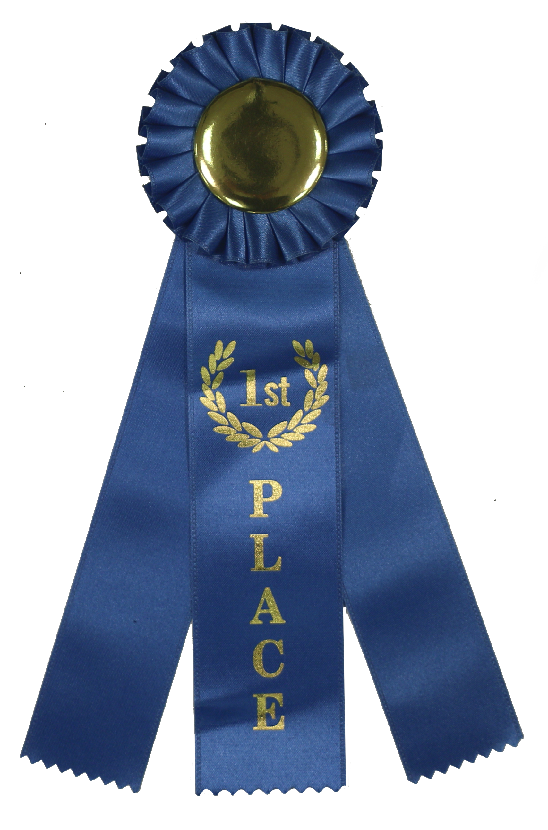
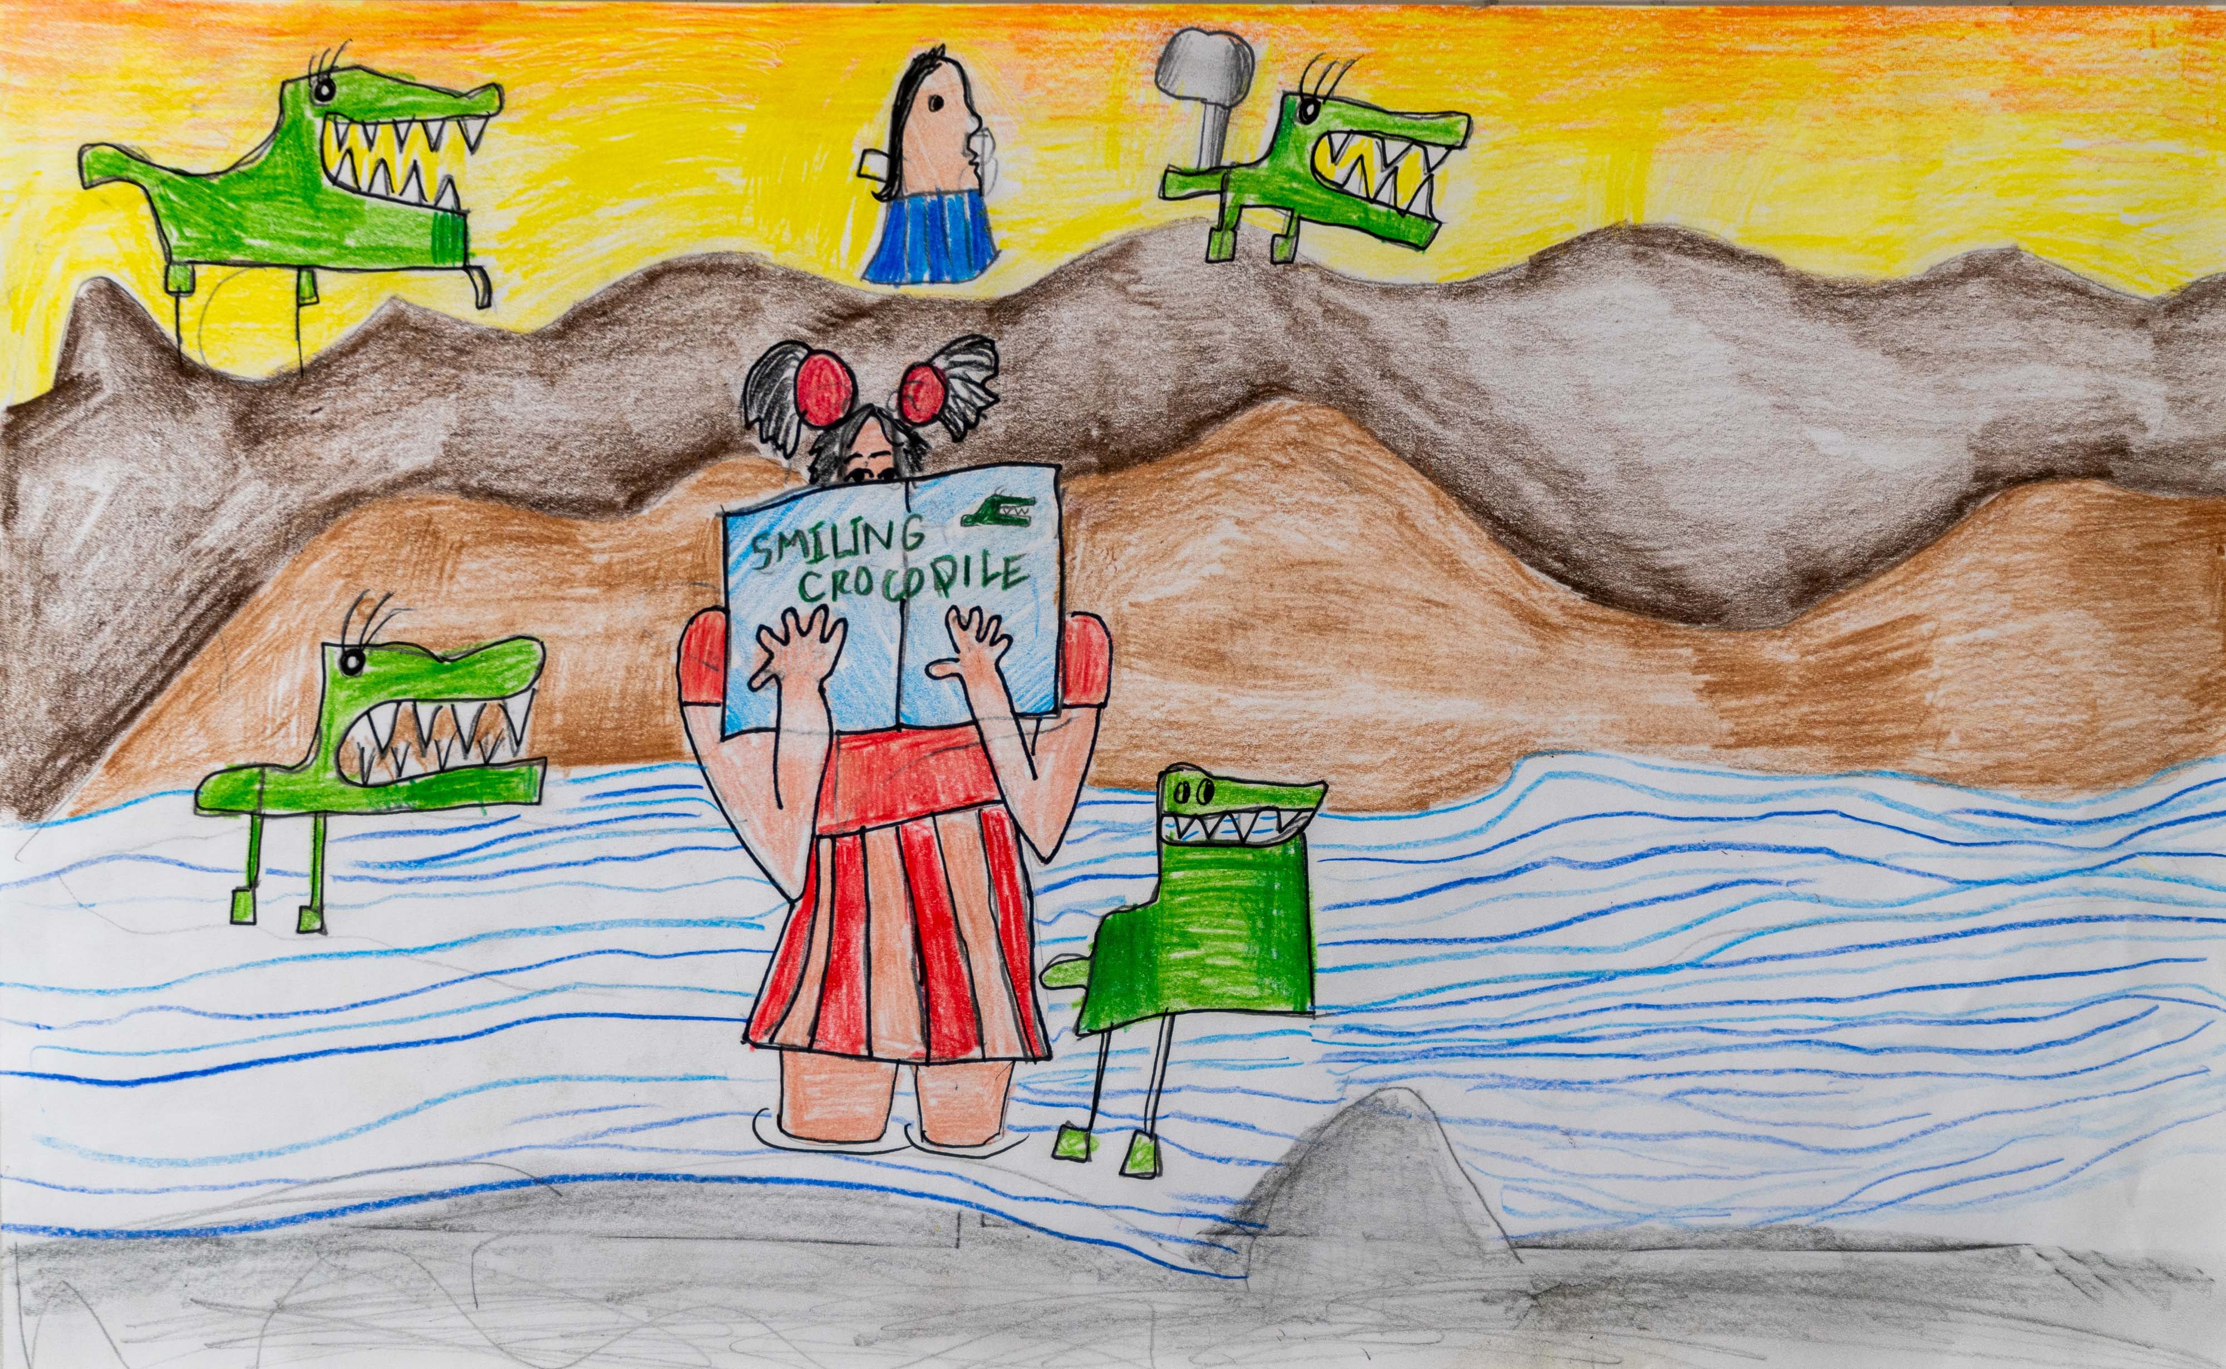
1st Place Winner
Audriana White
Division 1: K – 2nd Grade
Fairfield Magnet School
for Math & Science
Fairfield School District
Teacher: Kimi Daly

Slide 10
Division 2
Grades 3 - 5

Slide 11
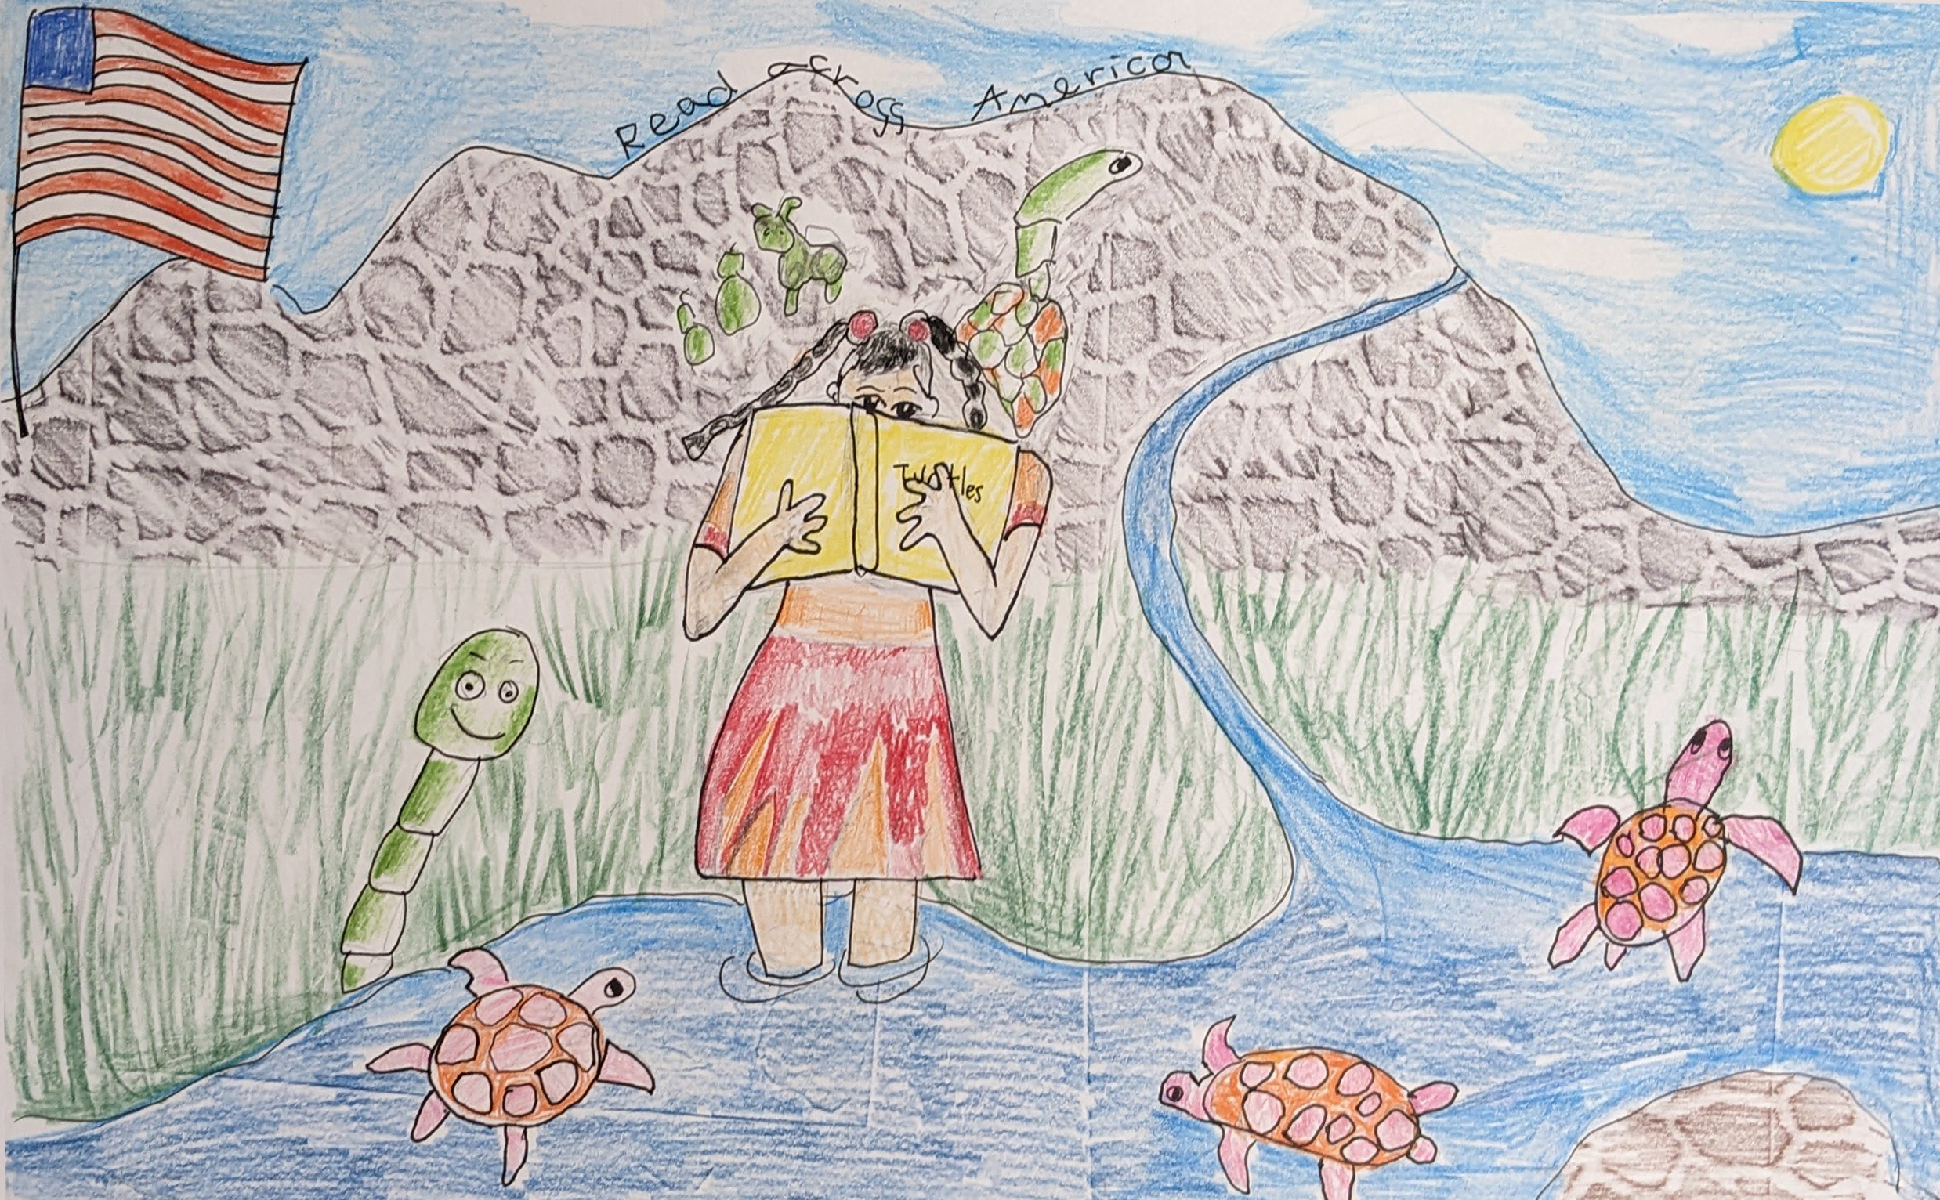
Honorable Mention
Morgan Huges
Division 2: 3 – 5th Grade
Fairfield Magnet School for Math & Science
Fairfield School District
Teacher: Kimi Daly

Slide 12
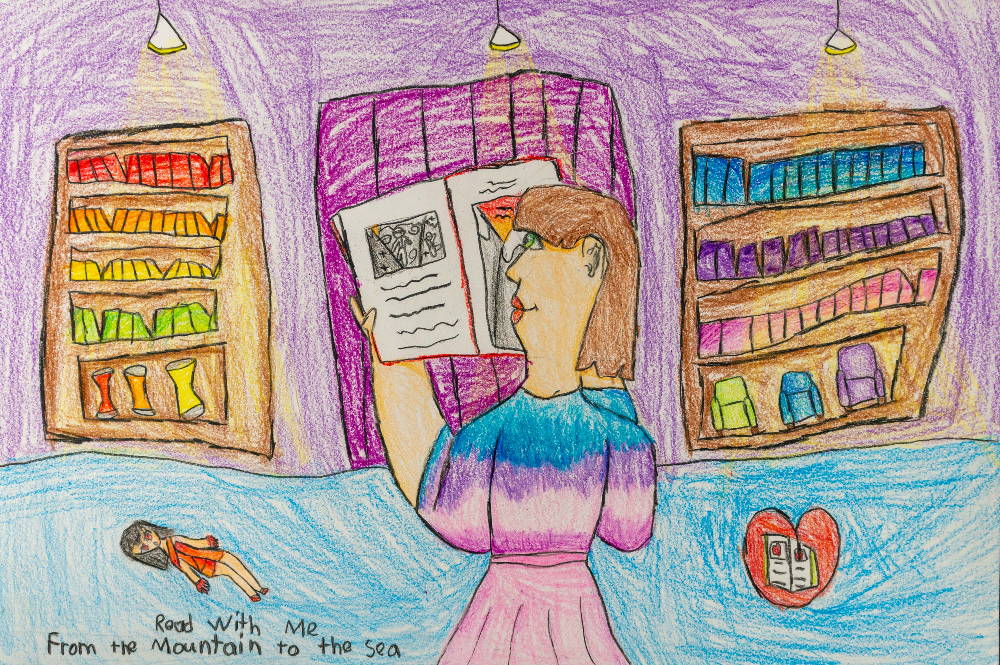
Honorable Mention
Jenifer Clavel
Division 2: 3 – 5th Grade
Arden Elementary School
Richland County School
District One
Teacher: George Sims

Slide 13
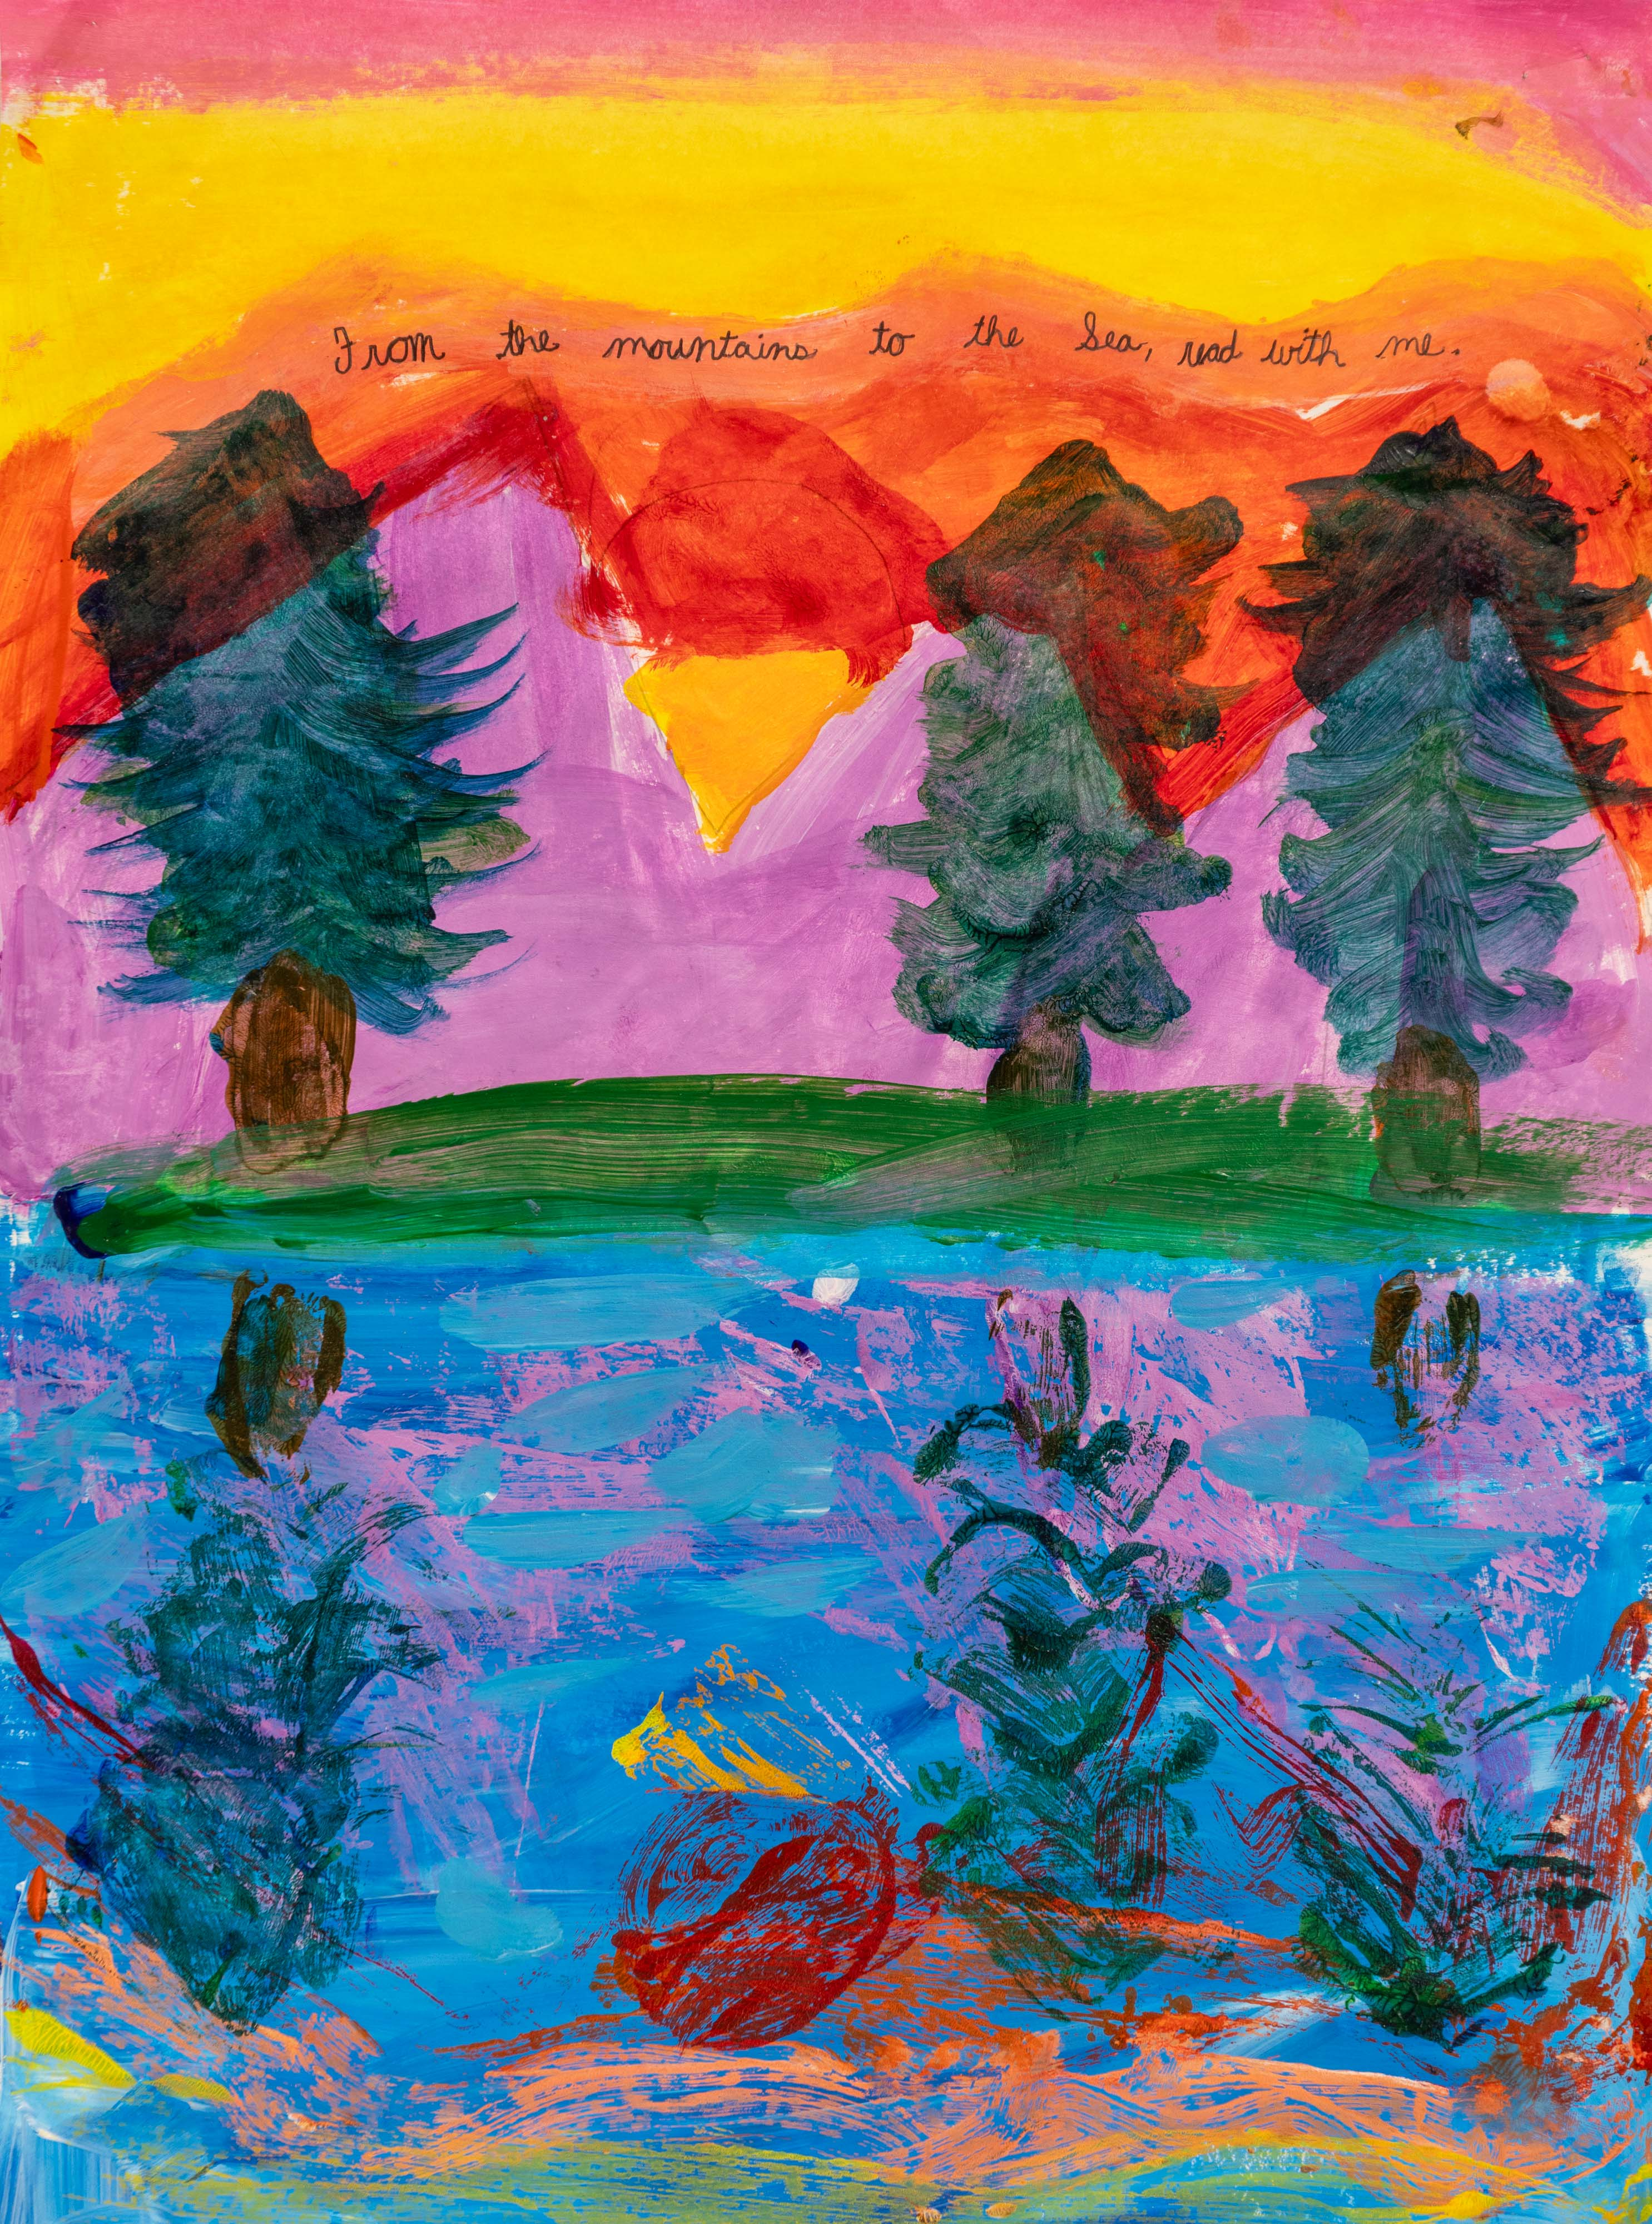
Honorable Mention
Maggie Brown
Division 2: 3 – 5th Grade
Camperdown Academy
Greenville County School District
Teacher: Ruth Thomas

Slide 14
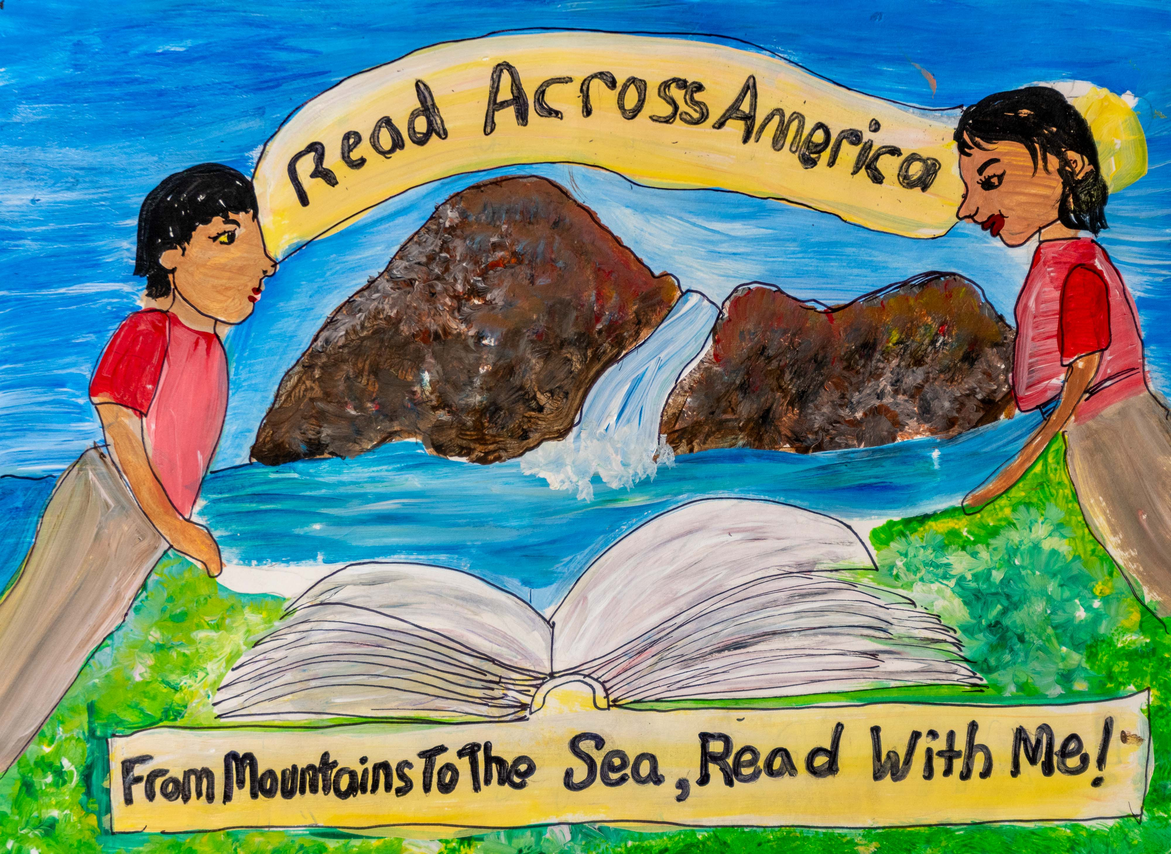
Honorable Mention
Kenya Pauling
Division 2: 3 – 5th Grade
Fairfield Magnet School for Math & Science
Fairfield County School District
Teacher: Kimi Daly

Slide 15
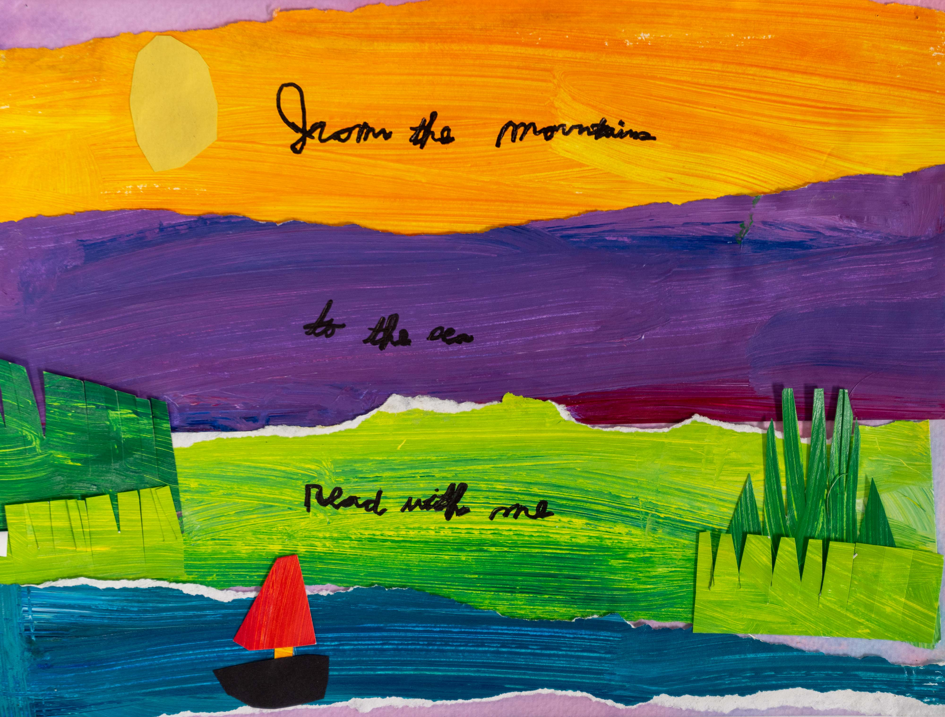
Honorable Mention
Sajan Patel
Division 2: 3 – 5th Grade
Camperdown Academy
Greenville County School District
Teacher: Ruth Thomas

Slide 16
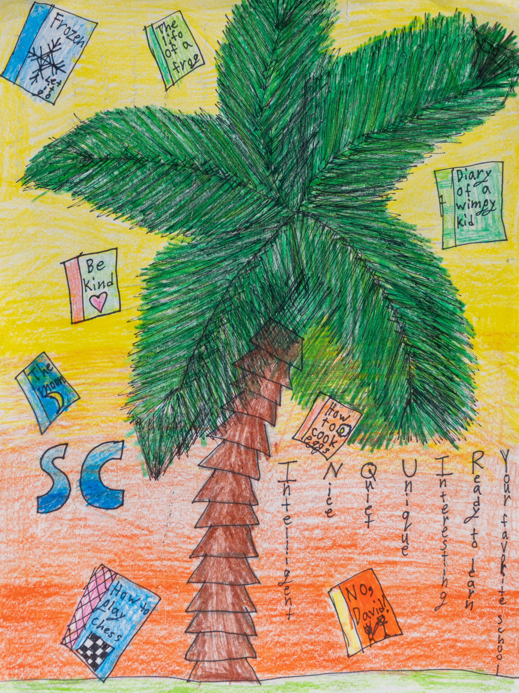
3rd Place Winner
Serenity Foster
Division 2: 3 – 5th Grade
Chester Park Elementary
School of Inquiry
Chester County School District
Teacher: Jamie Rankin

Slide 17
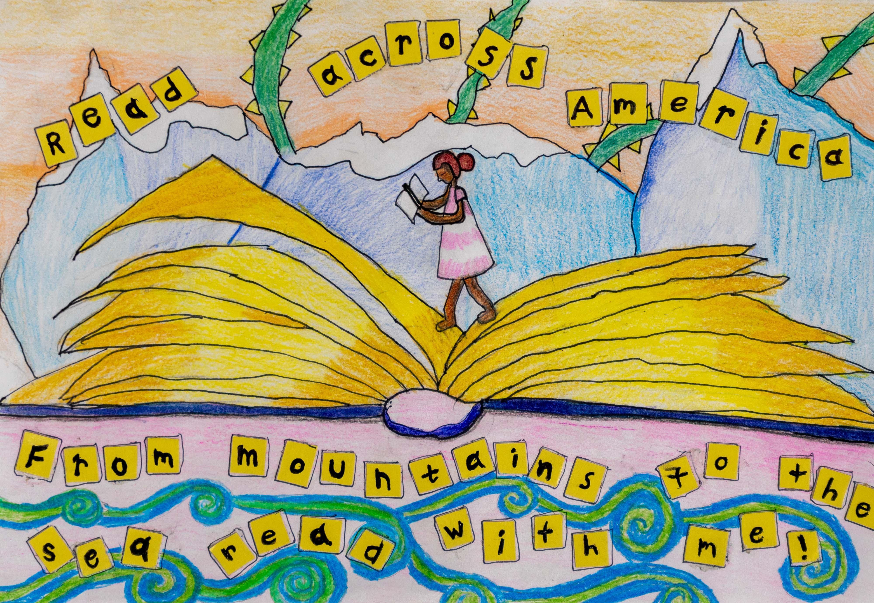
2nd Place Winner
Alaiyah Gatson
Division 2: 3 – 5th Grade
Fairfield Magnet School
for Math & Science
Fairfield School District
Teacher: Kimi Daly

Slide 18
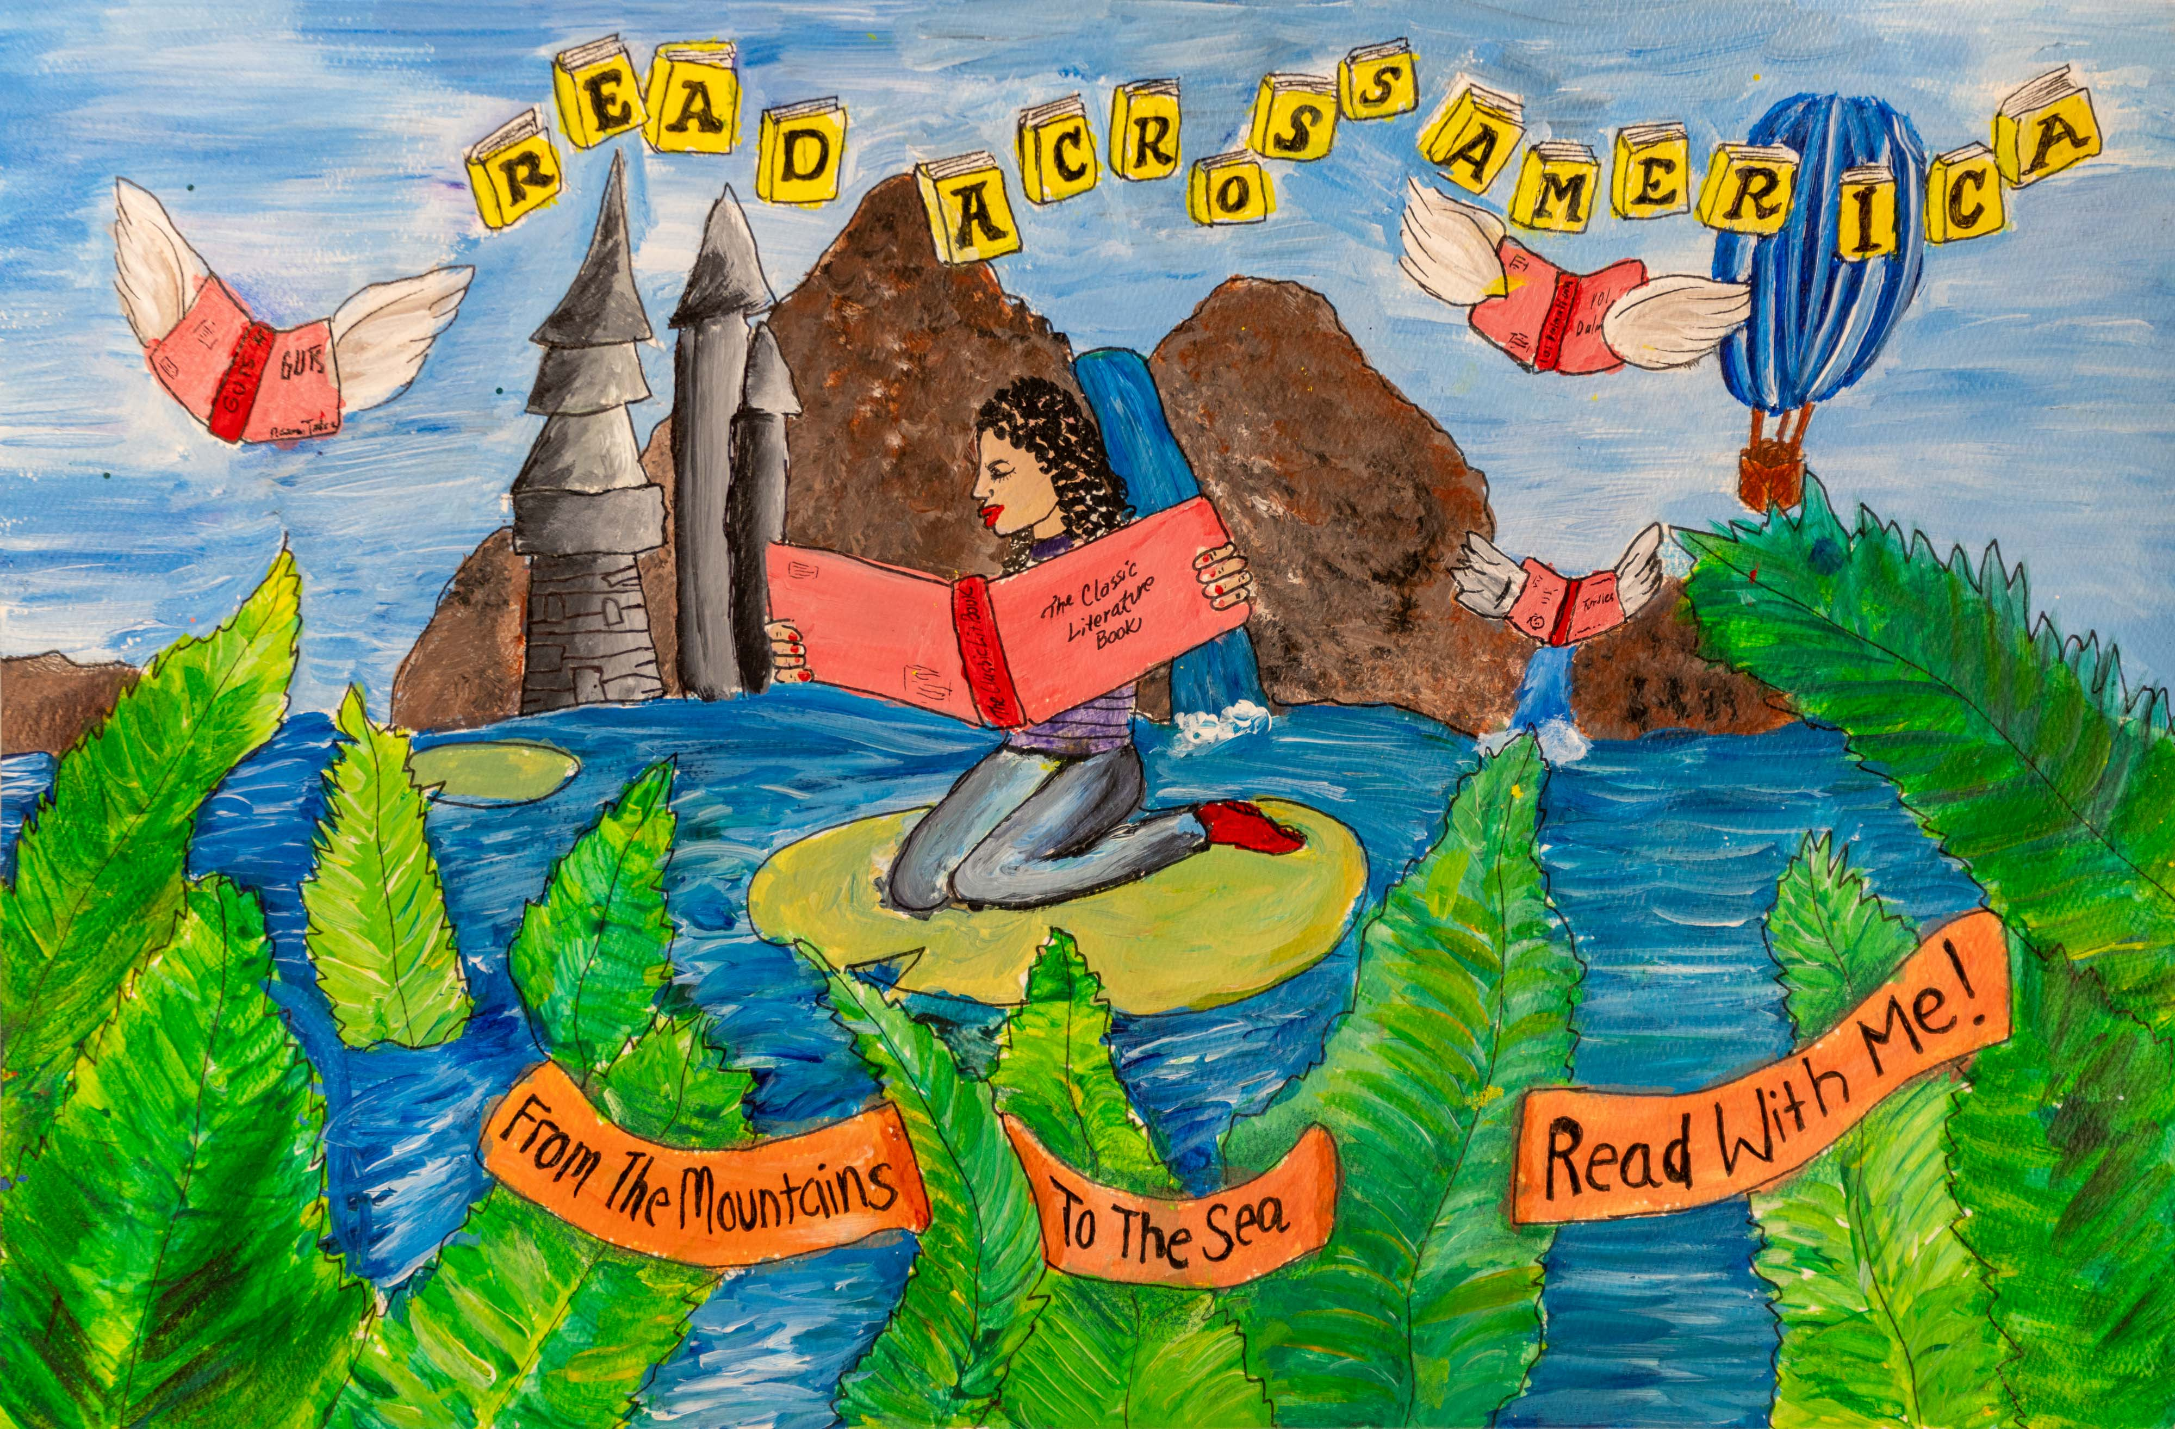
1st Place Winner
Paris Davis
Division 2: 3 – 5th Grade
Fairfield Magnet School
for Math & Science
Fairfield School District
Teacher: Kimi Daly

Slide 19
Division 3
Grades 6 - 8

Slide 20
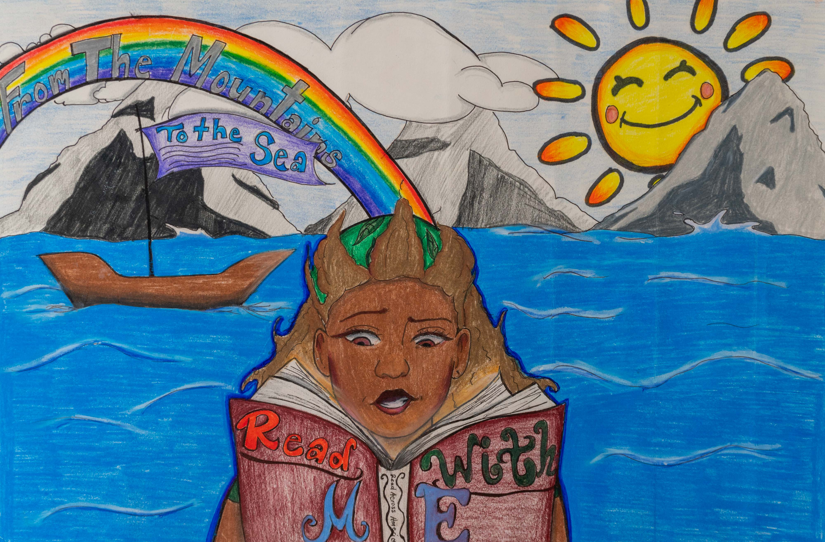
Honorable Mention
Shia Millen
Division 3: 6 – 8th Grade
William J. Clark Middle School
Orangeburg School District
Teacher: Malissa Wright

Slide 21
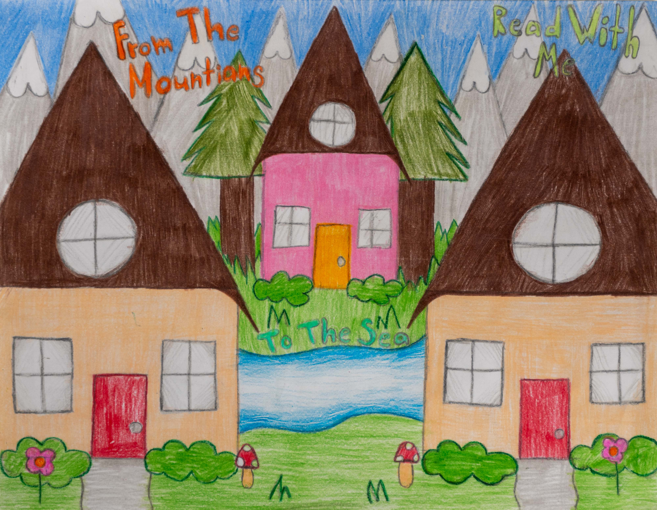
Honorable Mention
Kimberly Torres-Lopez
Division 3: 6 – 8th Grade
Harleyville-Ridgeville Middle School
Dorchester School District 4
Teacher: Carmen Bilton

Slide 22
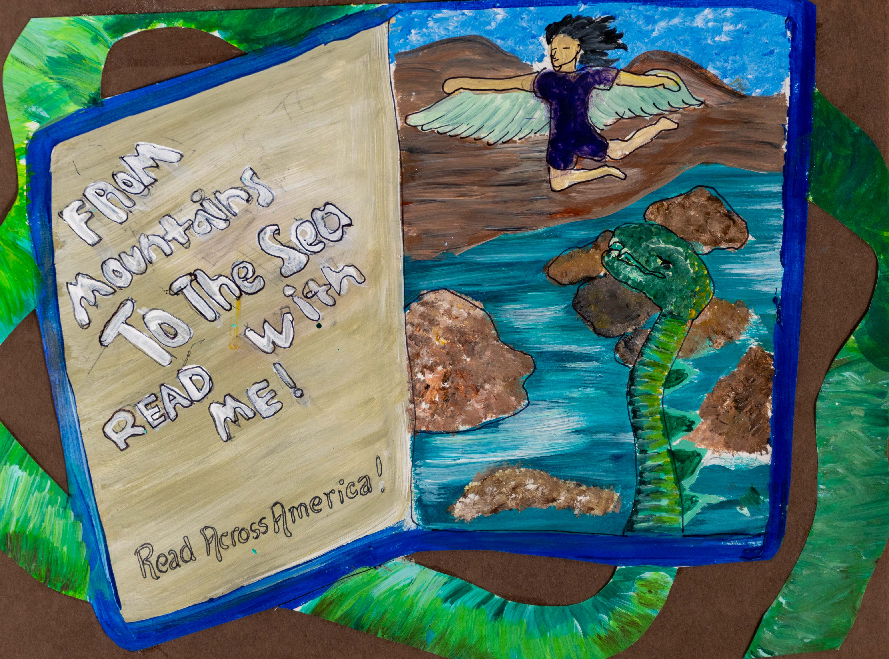
Honorable Mention
Taylor Brown
Division 3: 6 – 8th Grade
Fairfield Magnet School for
Math & Science
Fairfield County School District
Teacher: Kimi Daly

Slide 23
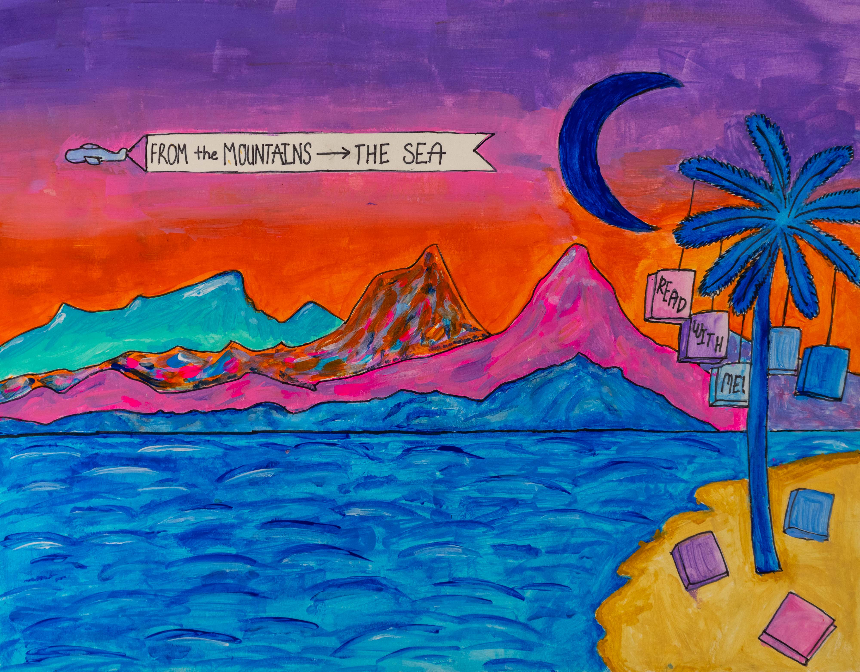
Honorable Mention
Sophia Price
Division 3: 6 – 8th Grade
Seneca Middle School
Oconee County School District
Teacher: Mara Diaz

Slide 24
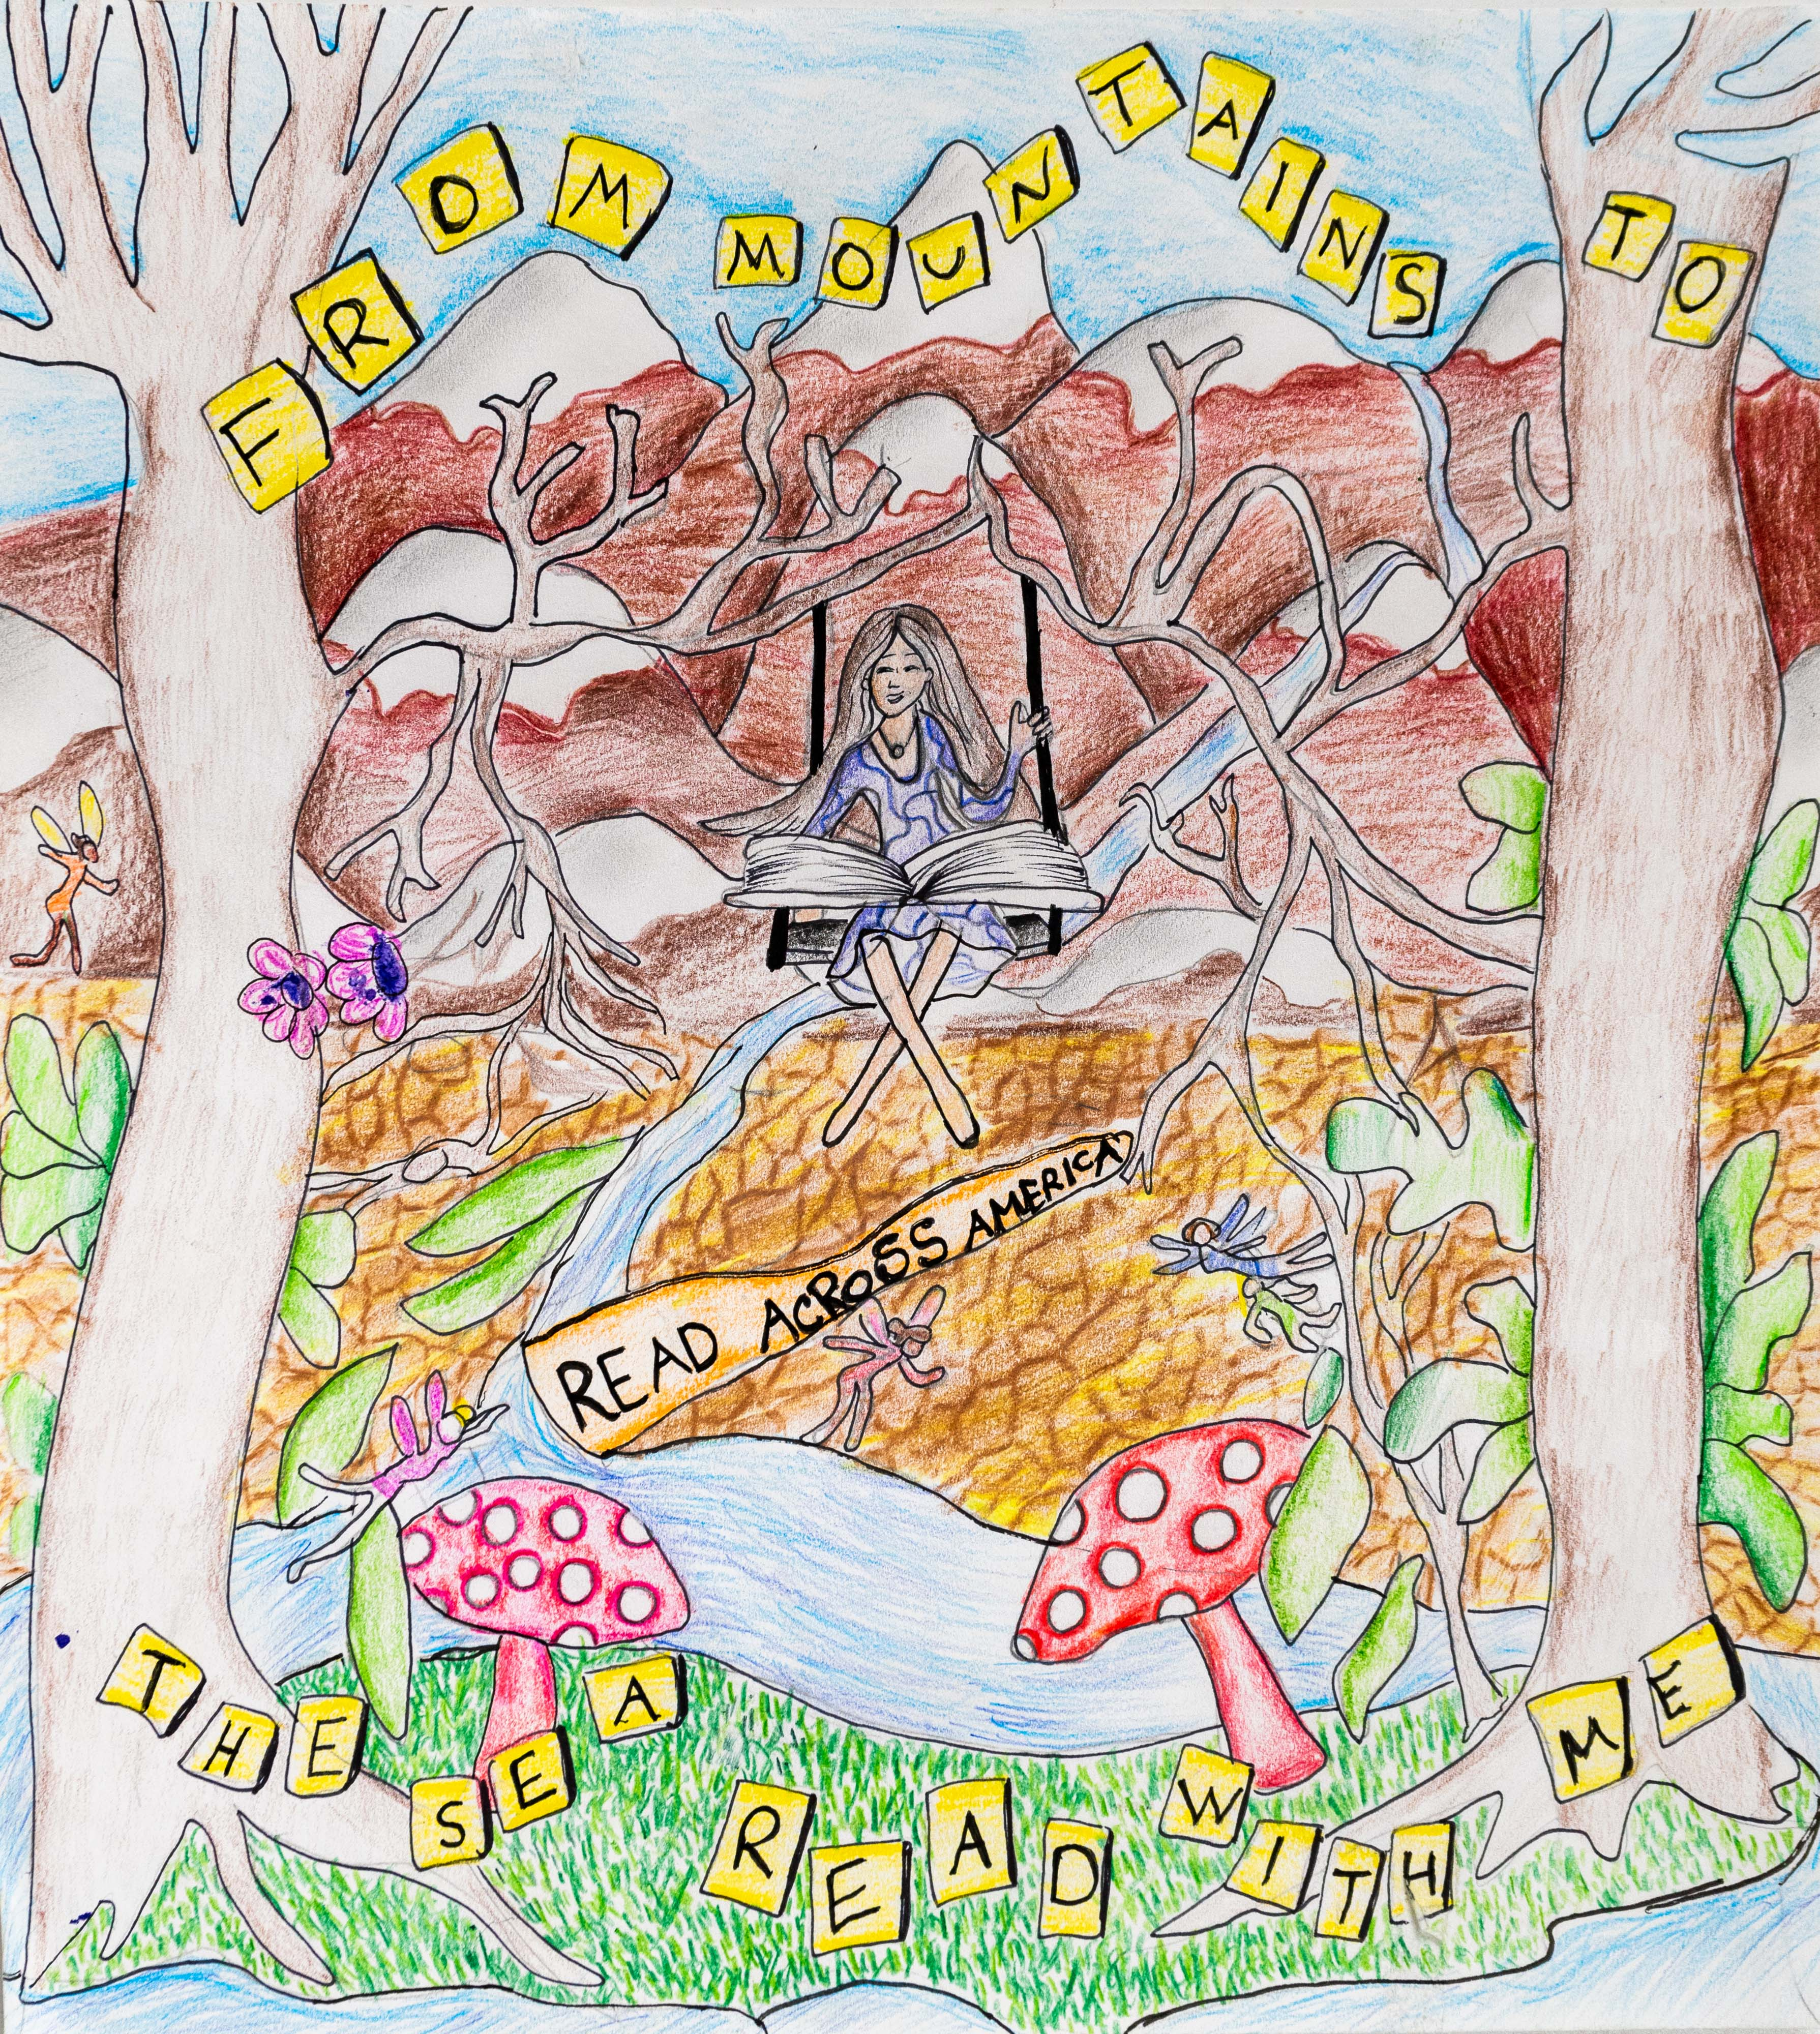
Honorable Mention
Mirtza Daniella Zavala Nabra
Division 3: 6 – 8th Grade
Fairfield Magnet School for
Math & Science
Fairfield County School District
Teacher: Kimi Daly

Slide 25
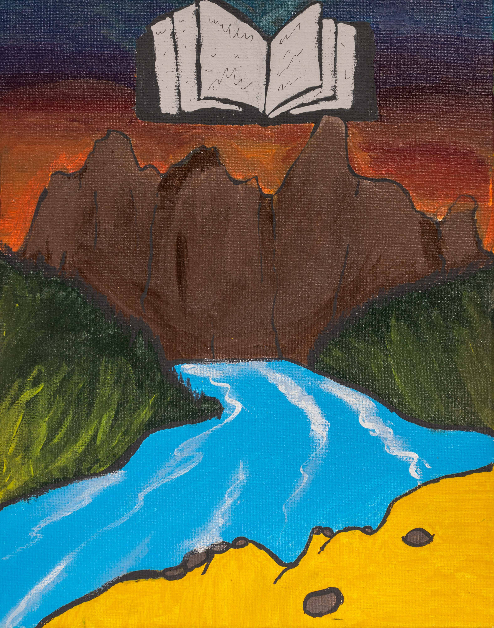
Honorable Mention
Sherod Garvin
Division 3: 6 – 8th Grade
Williston Elko High School
Barnell County Consolidated School District
Teacher: Morgan Sanders

Slide 26
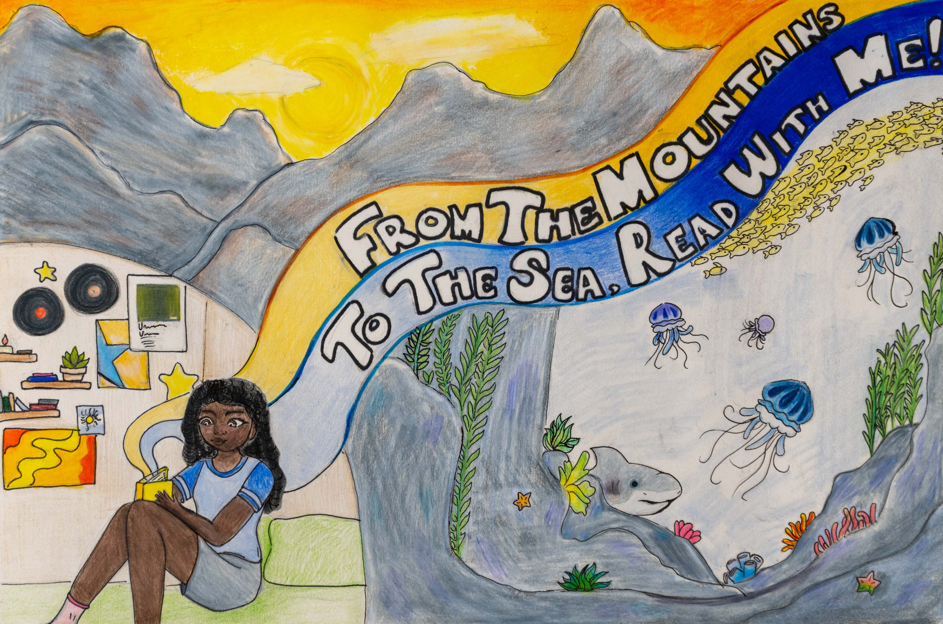
Honorable Mention
Harmony Dreher
Division 3: 6 – 8th Grade
William J. Clark Middle School
Orangeburg School District
Teacher: Malissa Wright

Slide 27
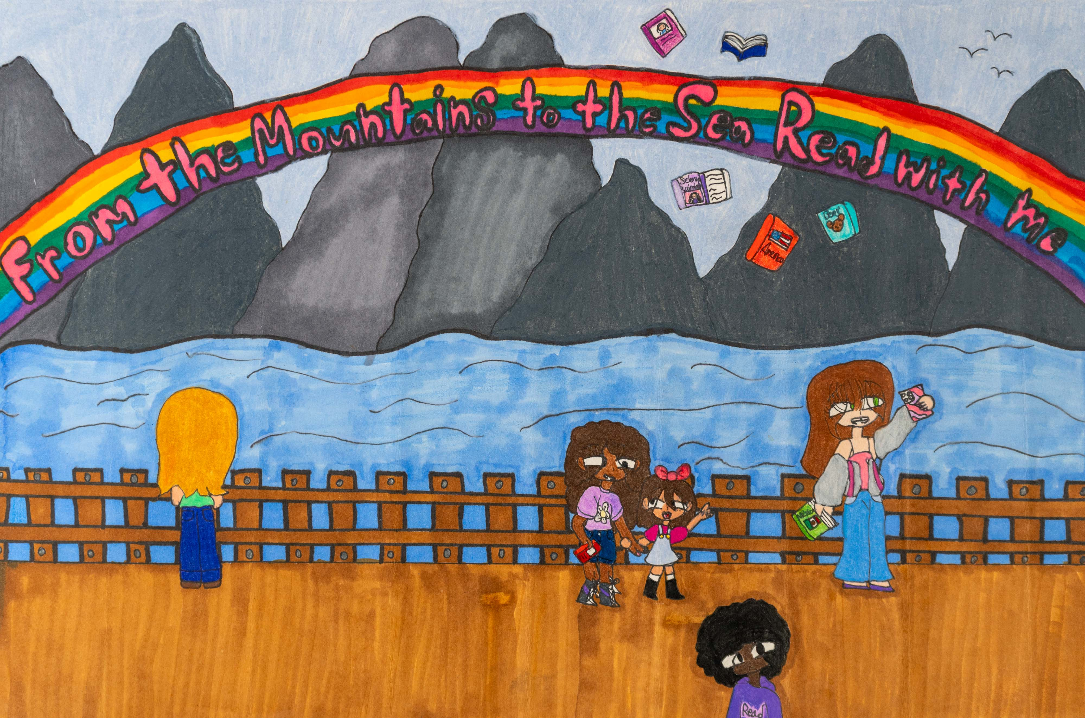
Honorable Mention
Nicole Ortiz
Division 3: 6 – 8th Grade
William J. Clark Middle School
Orangeburg School District
Teacher: Malissa Wright

Slide 28
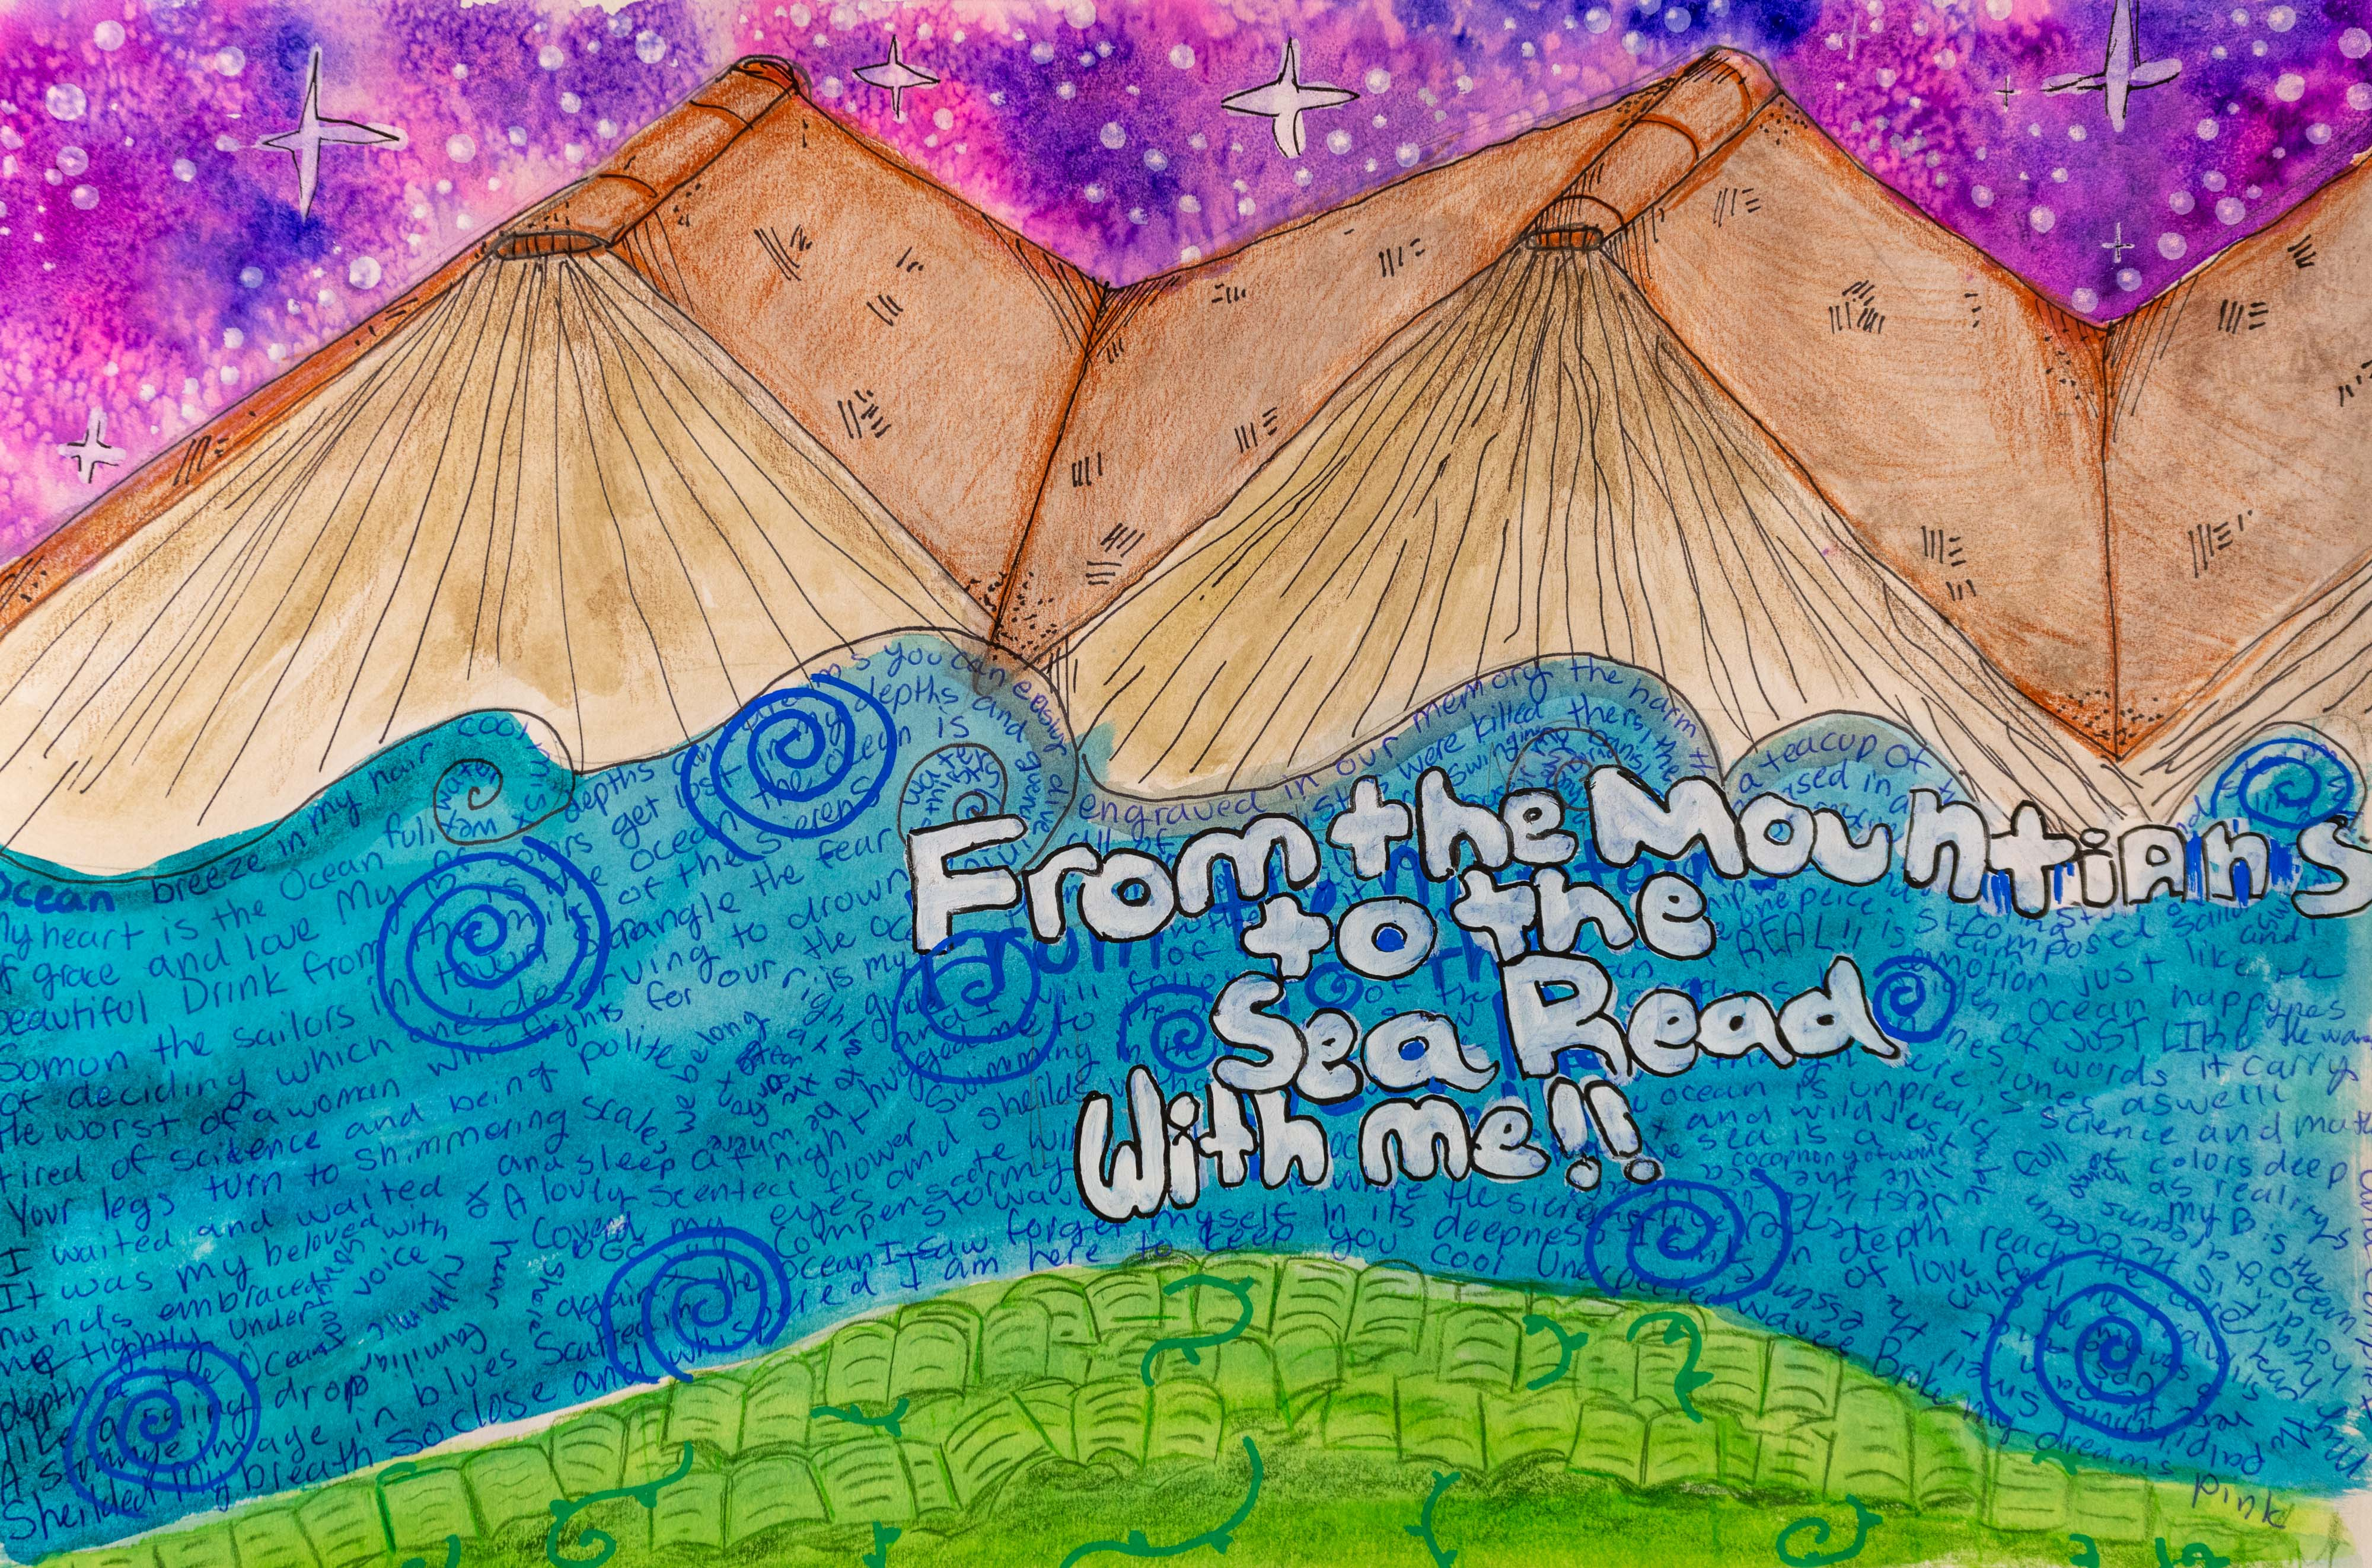
3rd Place Winner
Henry Sease
Division 3: 6 – 8th Grade
Buist Academy
Charleston County
School District
Teacher: Wendie Kilgore

Slide 29
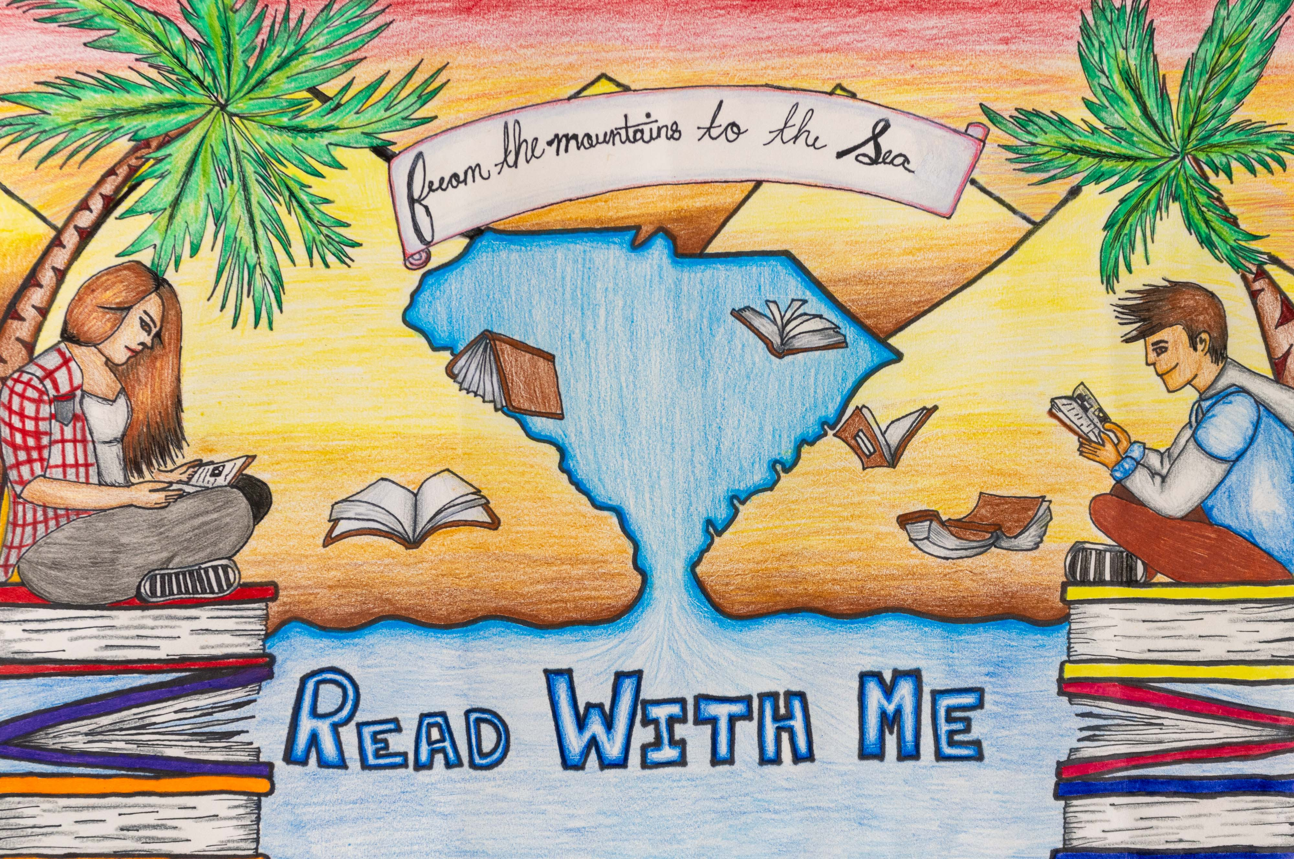
2nd Place Winner
Prajwala Peddapalli
Division 3: 6 – 8th Grade
William J. Clark Middle School
Orangeburg County School District
Teacher: Malissa Wright

Slide 30
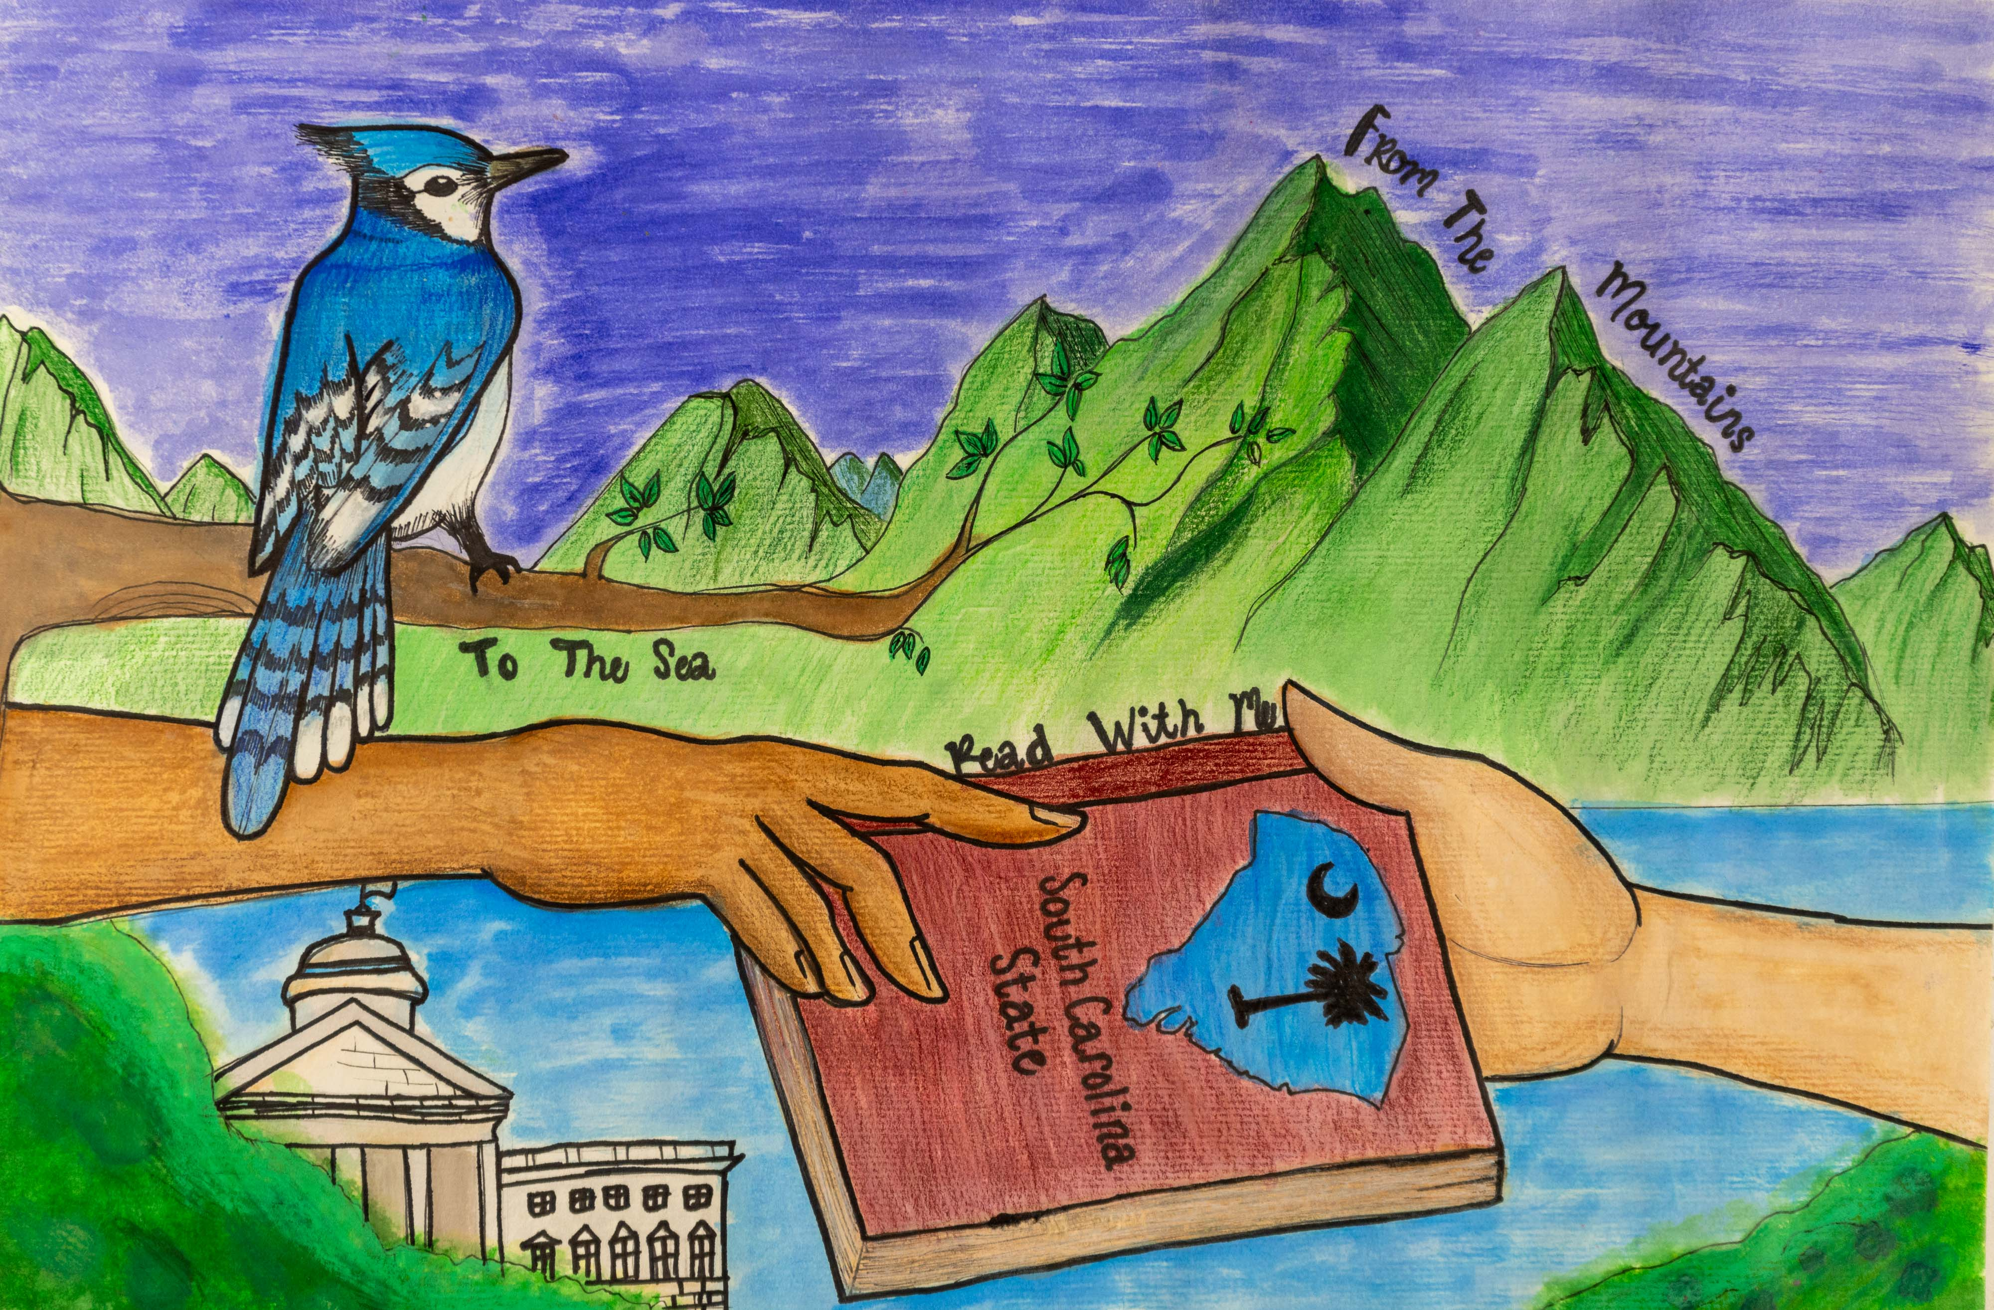
1st Place Winner
Hanika Faith DeGracia
Division 3: 6 – 8th Grade
William J. Clark Middle School
Orangeburg County School District
Teacher: Malissa Wright

Slide 31
Division 4
Grades 9 - 12

Slide 32
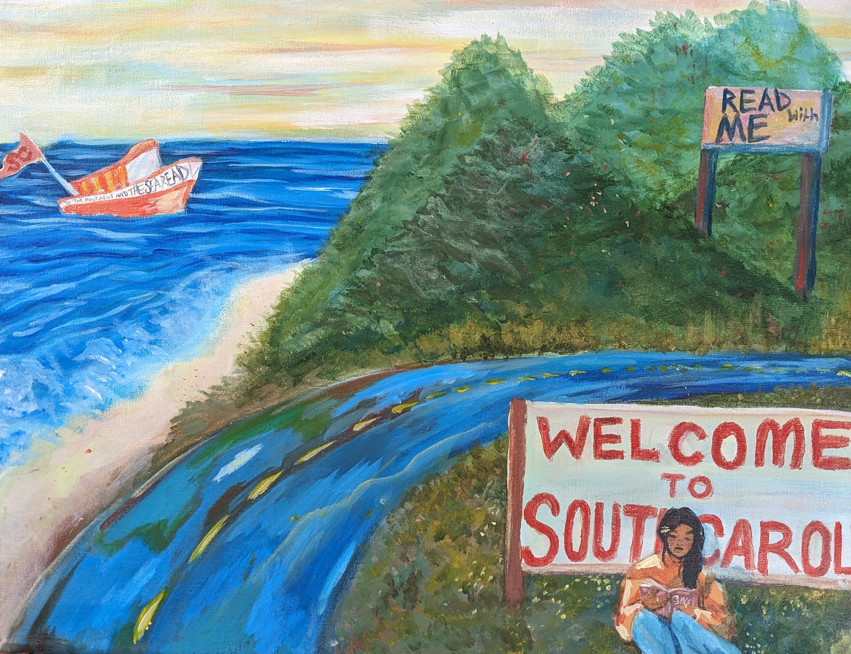
Honorable Mention
Willie Tozzi
Division 4: 9 – 12th Grade
North Myrtle Beach High School
Horry County School District
Teachers: Tina Martin &
Lauren Woodward

Slide 33
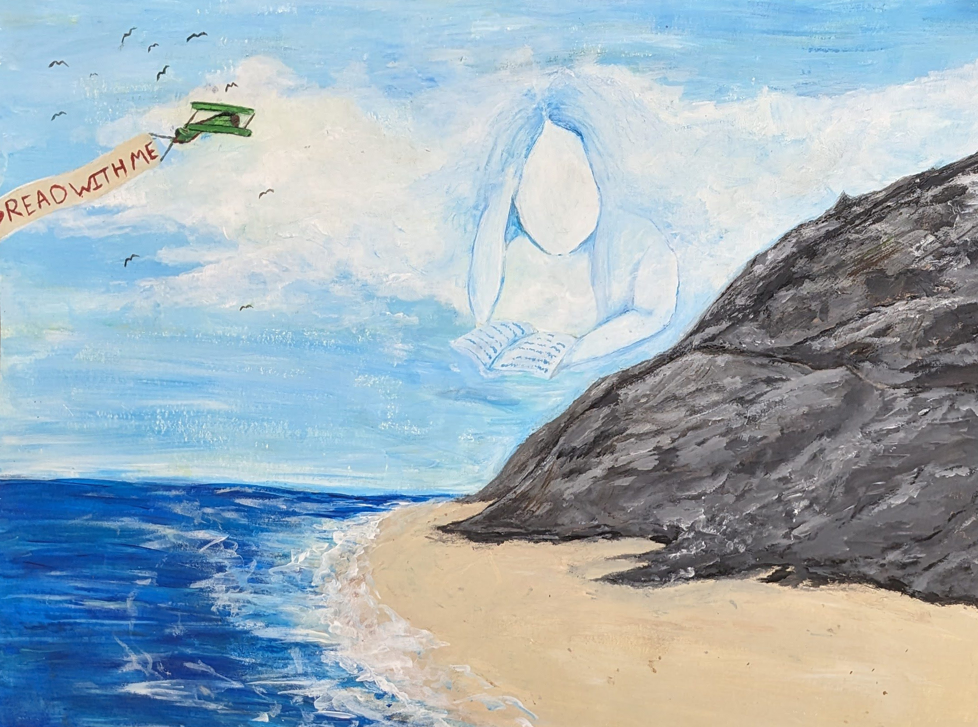
Honorable Mention
Milo Goodson
Division 4: 9 – 12th Grade
North Myrtle Beach High School
Horry County School District
Teachers: Tina Martin &
Lauren Woodward

Slide 34

3rd Place Winner
Ky’Mari Johnson
Division 4: 9 – 12th Grade
Orangeburg Wilkinson
High School
Orangeburg School District
Teacher: Kima Remekie

Slide 35
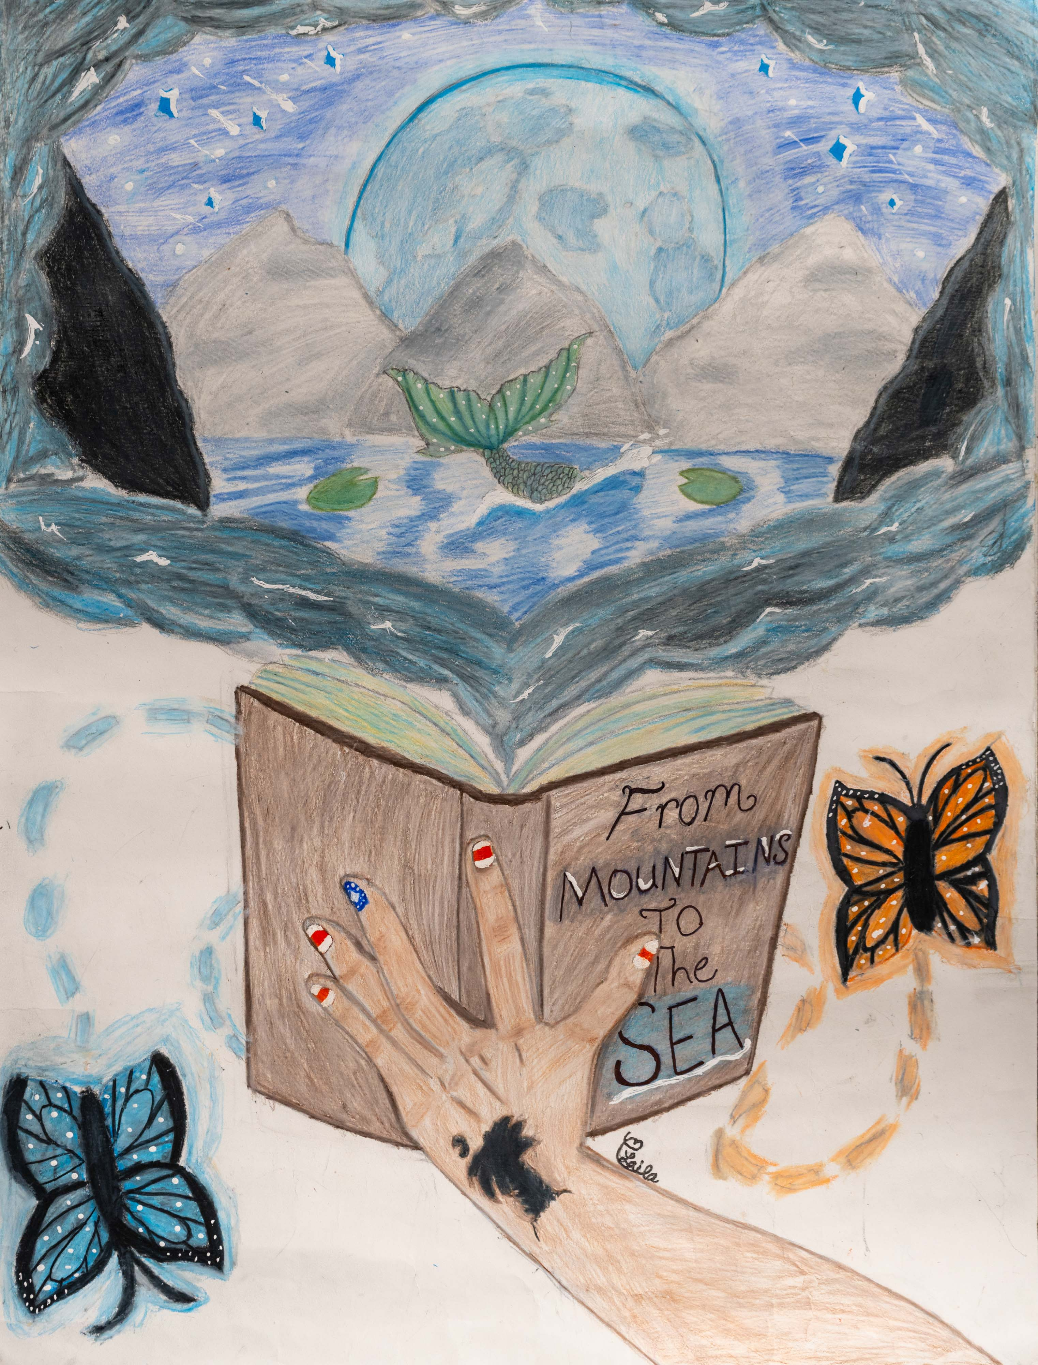
2nd Place Winner
Laila Chavais
Division 4: 9 – 12th Grade
Williston Elko High School
Barnell County Consolidated School District
Teacher: Morgan Sanders

Slide 36
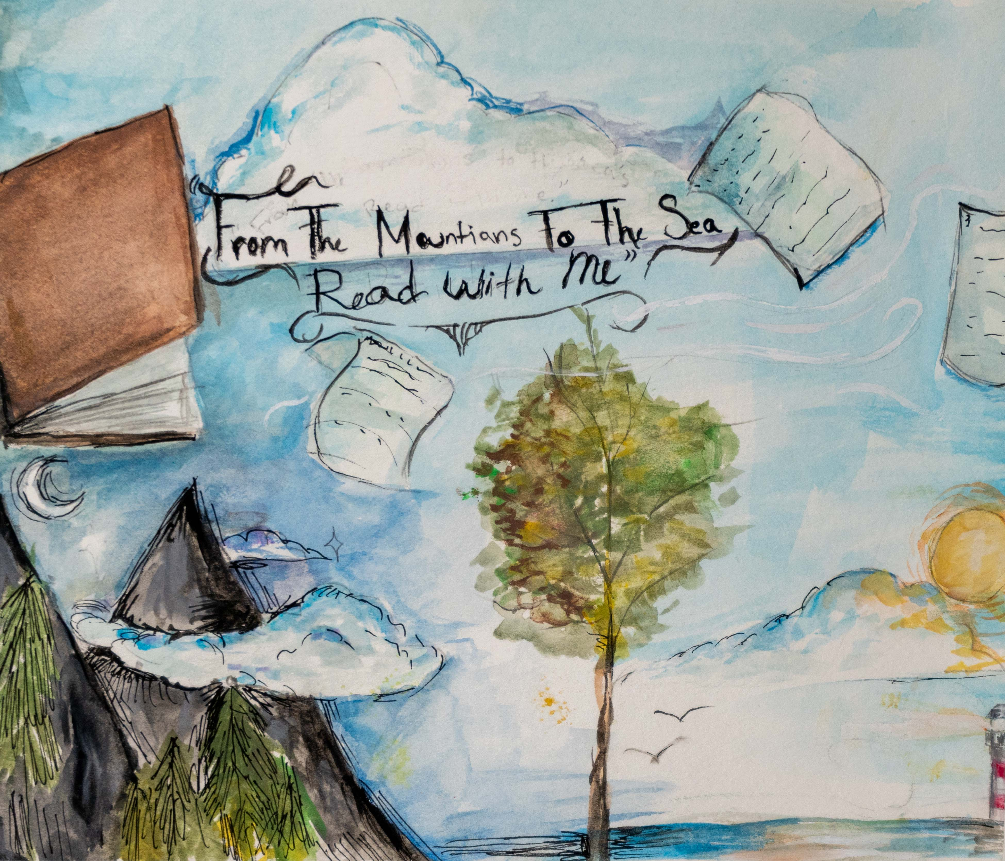
1st Place Winner
Sklyer Cromer
Division 4: 9 – 12th Grade
North Myrtle Beach High School
Horry County School District
Teacher: Tina Martin
& Lauren Woodward

Slide 37
Division 5
DIGITAL ART

Slide 38

Honorable Mention
Zyir Vamper
Division 5: Digital Art
Academy for the Arts, Science and Technology
Horry County School District
Teacher: Lesley Etherson

Slide 39
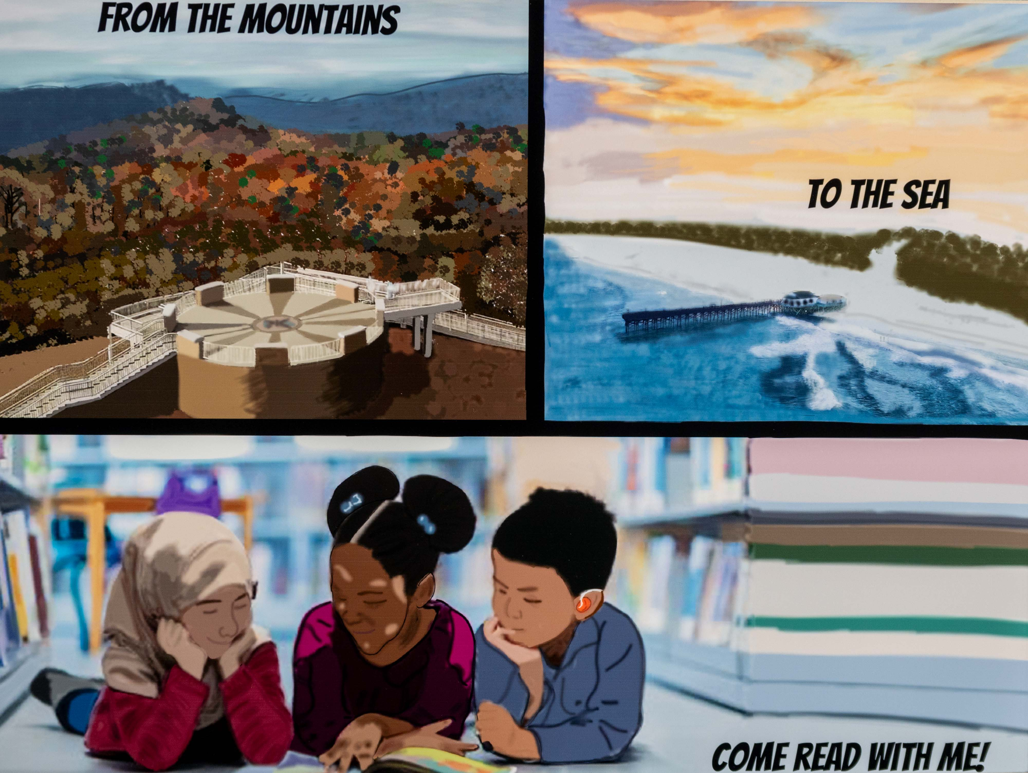
Honorable Mention
Gracie Leviner
Division 5: Digital Art
South Florence High School
Florence School District One
Teacher: Danielle Hubbard

Slide 40
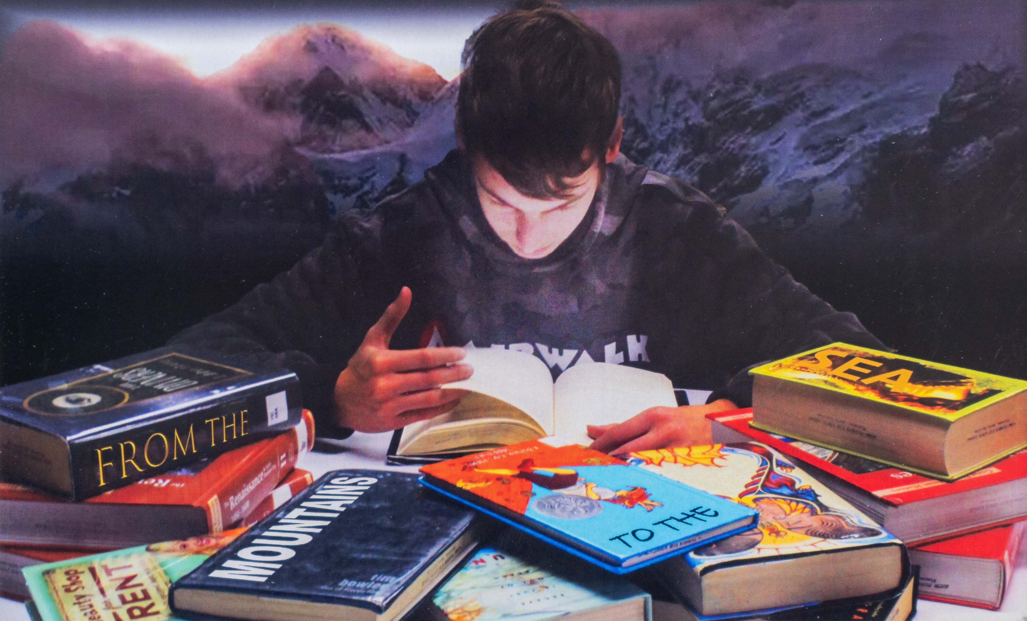
Honorable Mention
Aiden Franklin
Division 5: Digital Art
South Florence High School
Florence School District One
Teacher: Danielle Hubbard

Slide 41

Honorable Mention
Alexandra Belton
Division 5: Digital Art
Academy of Arts, Science
and Technology
Horry County School District
Teacher: Lesley Etherson

Slide 42

Honorable Mention
Jenna DiGiovanni
Division 5: Digital Art
Academy of Arts, Science
and Technology
Horry County School District
Teacher: Lesley Etherson

Slide 43
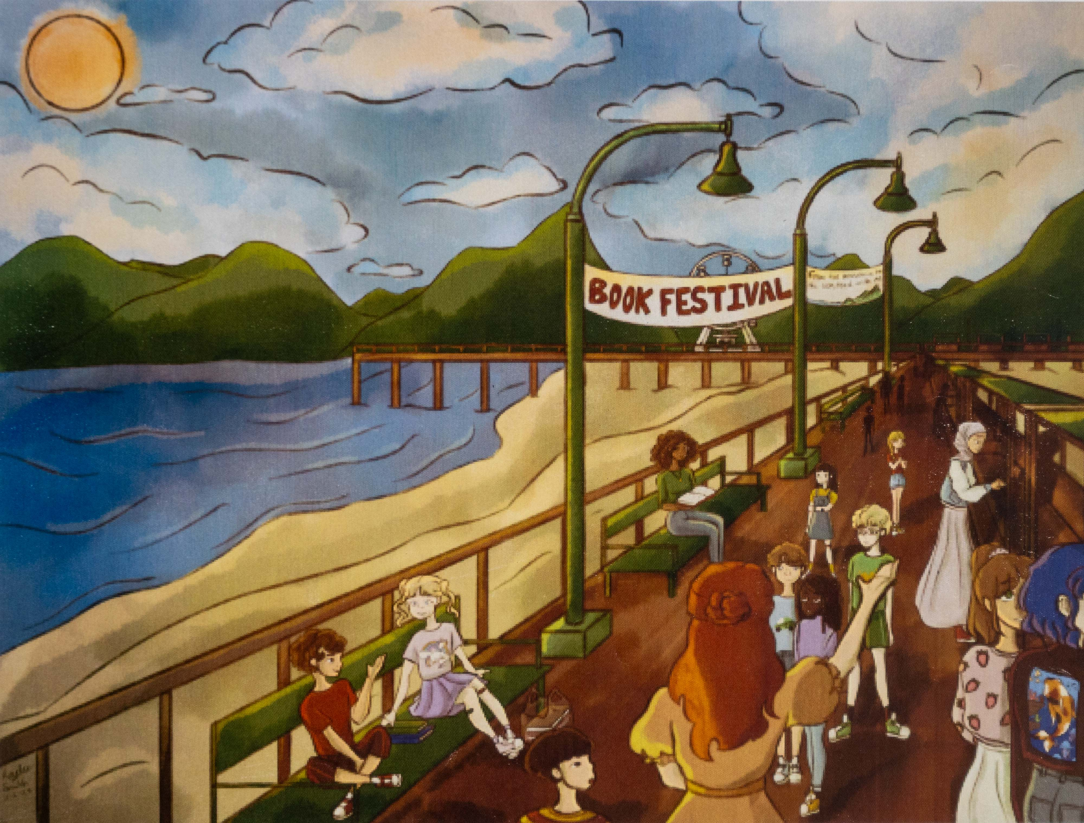
Honorable Mention
Kaylee Smith
Division 5: Digital Art
North Myrtle Beach High School
Horry County School District
Teacher: Tina Martin
& Lauren Woodward

Slide 44

3rd Place Winner
Brynn Smith
Division 5: Digital Art
Academy of Arts, Science
and Technology
Horry County School District
Teacher: Lesley Etherson

Slide 45
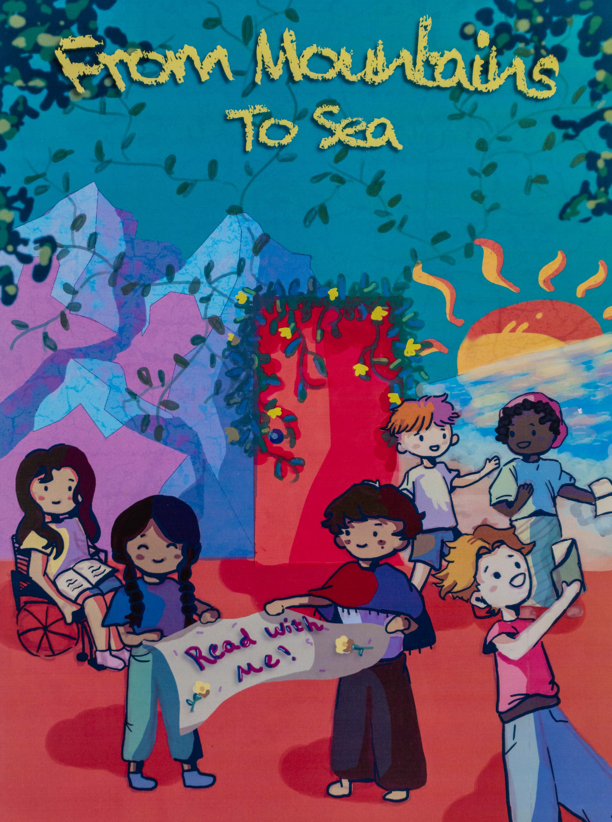
2nd Place Winner
Annabelle Carpentier
Division 5: Digital Art
Academy of Arts, Science
and Technology
Horry County School District
Teacher: Lesley Etherson

Slide 46
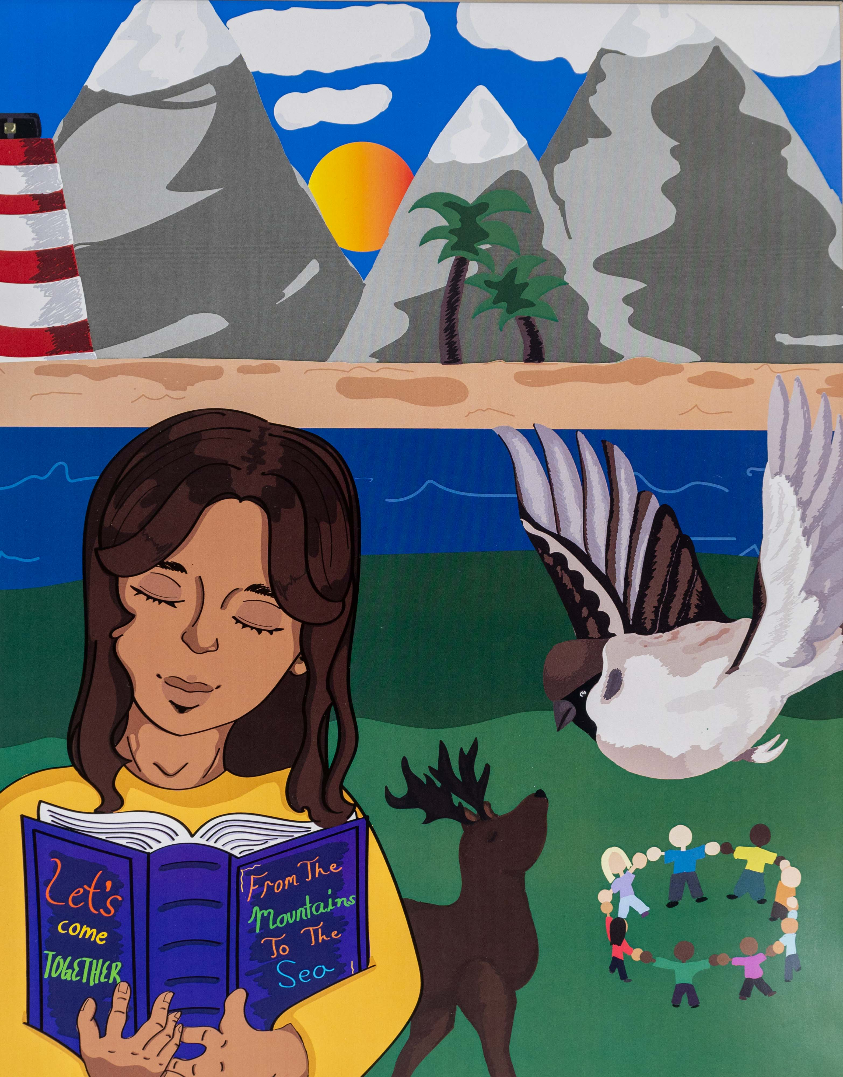
1st Place Winner
Andrea Scott
Division 5: Digital Art
South Florence High School
Florence School District One
Teacher: Danielle Hubbard

Slide 47
Division 5
Photography

Slide 48
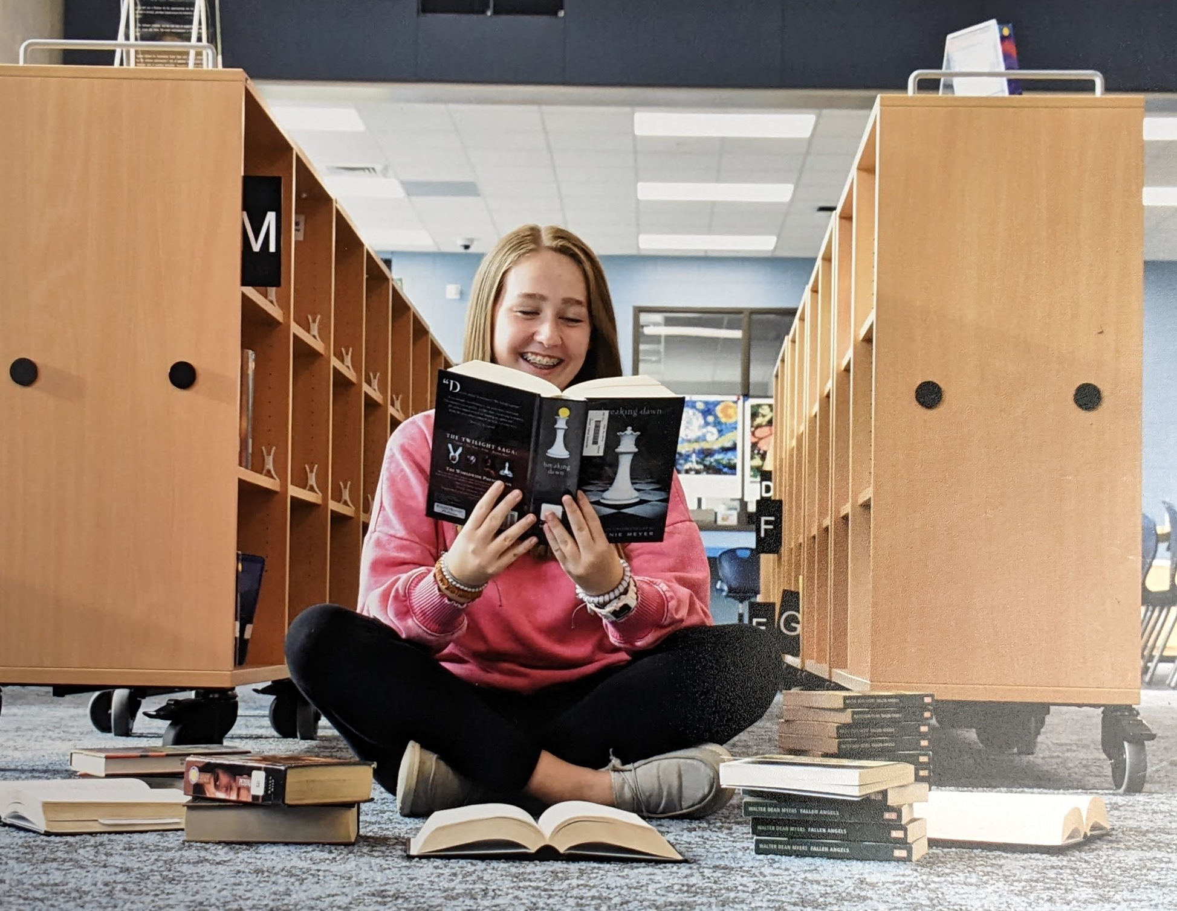
Honorable Mention
Caroline O’Dell
Division 6: Photography
Southside Middle School
Florence County School District One
Teacher: Robin Voss

Slide 49

Honorable Mention
Stewart Brown
Division 6: Photography
Southside Middle School
Florence County School District One
Teacher: Robin Voss

Slide 50

Honorable Mention
Amelia Russel
Division 6: Photography
Southside Middle School
Florence County School District One
Teacher: Robin Voss

Slide 51

3rd Place Winner
Khole Miles
Division 6: Photography
Southside Middle School
Florence County School District One
Teacher: Robin Voss

Slide 52
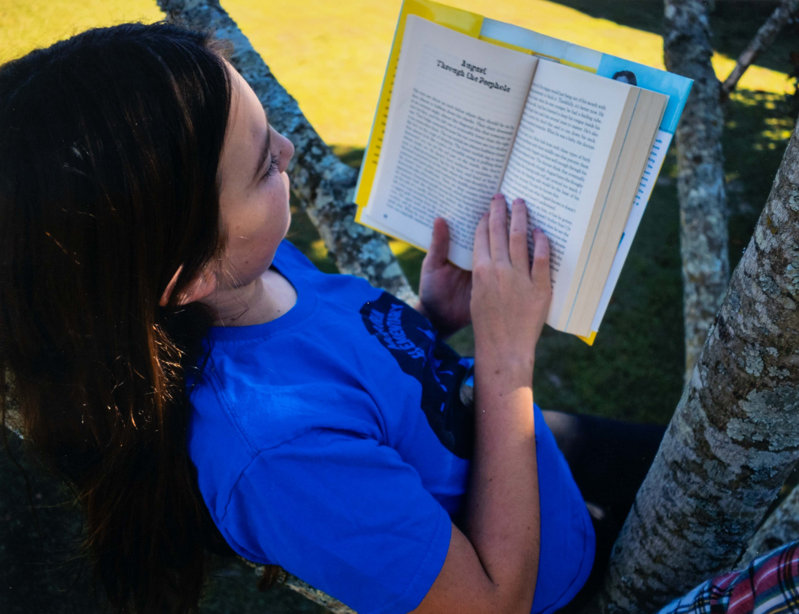
2nd Place Winner
Mary Beth Hickey
Division 6: Photography
Southside Middle School
Florence County School District One
Teacher: Robin Voss

Slide 53
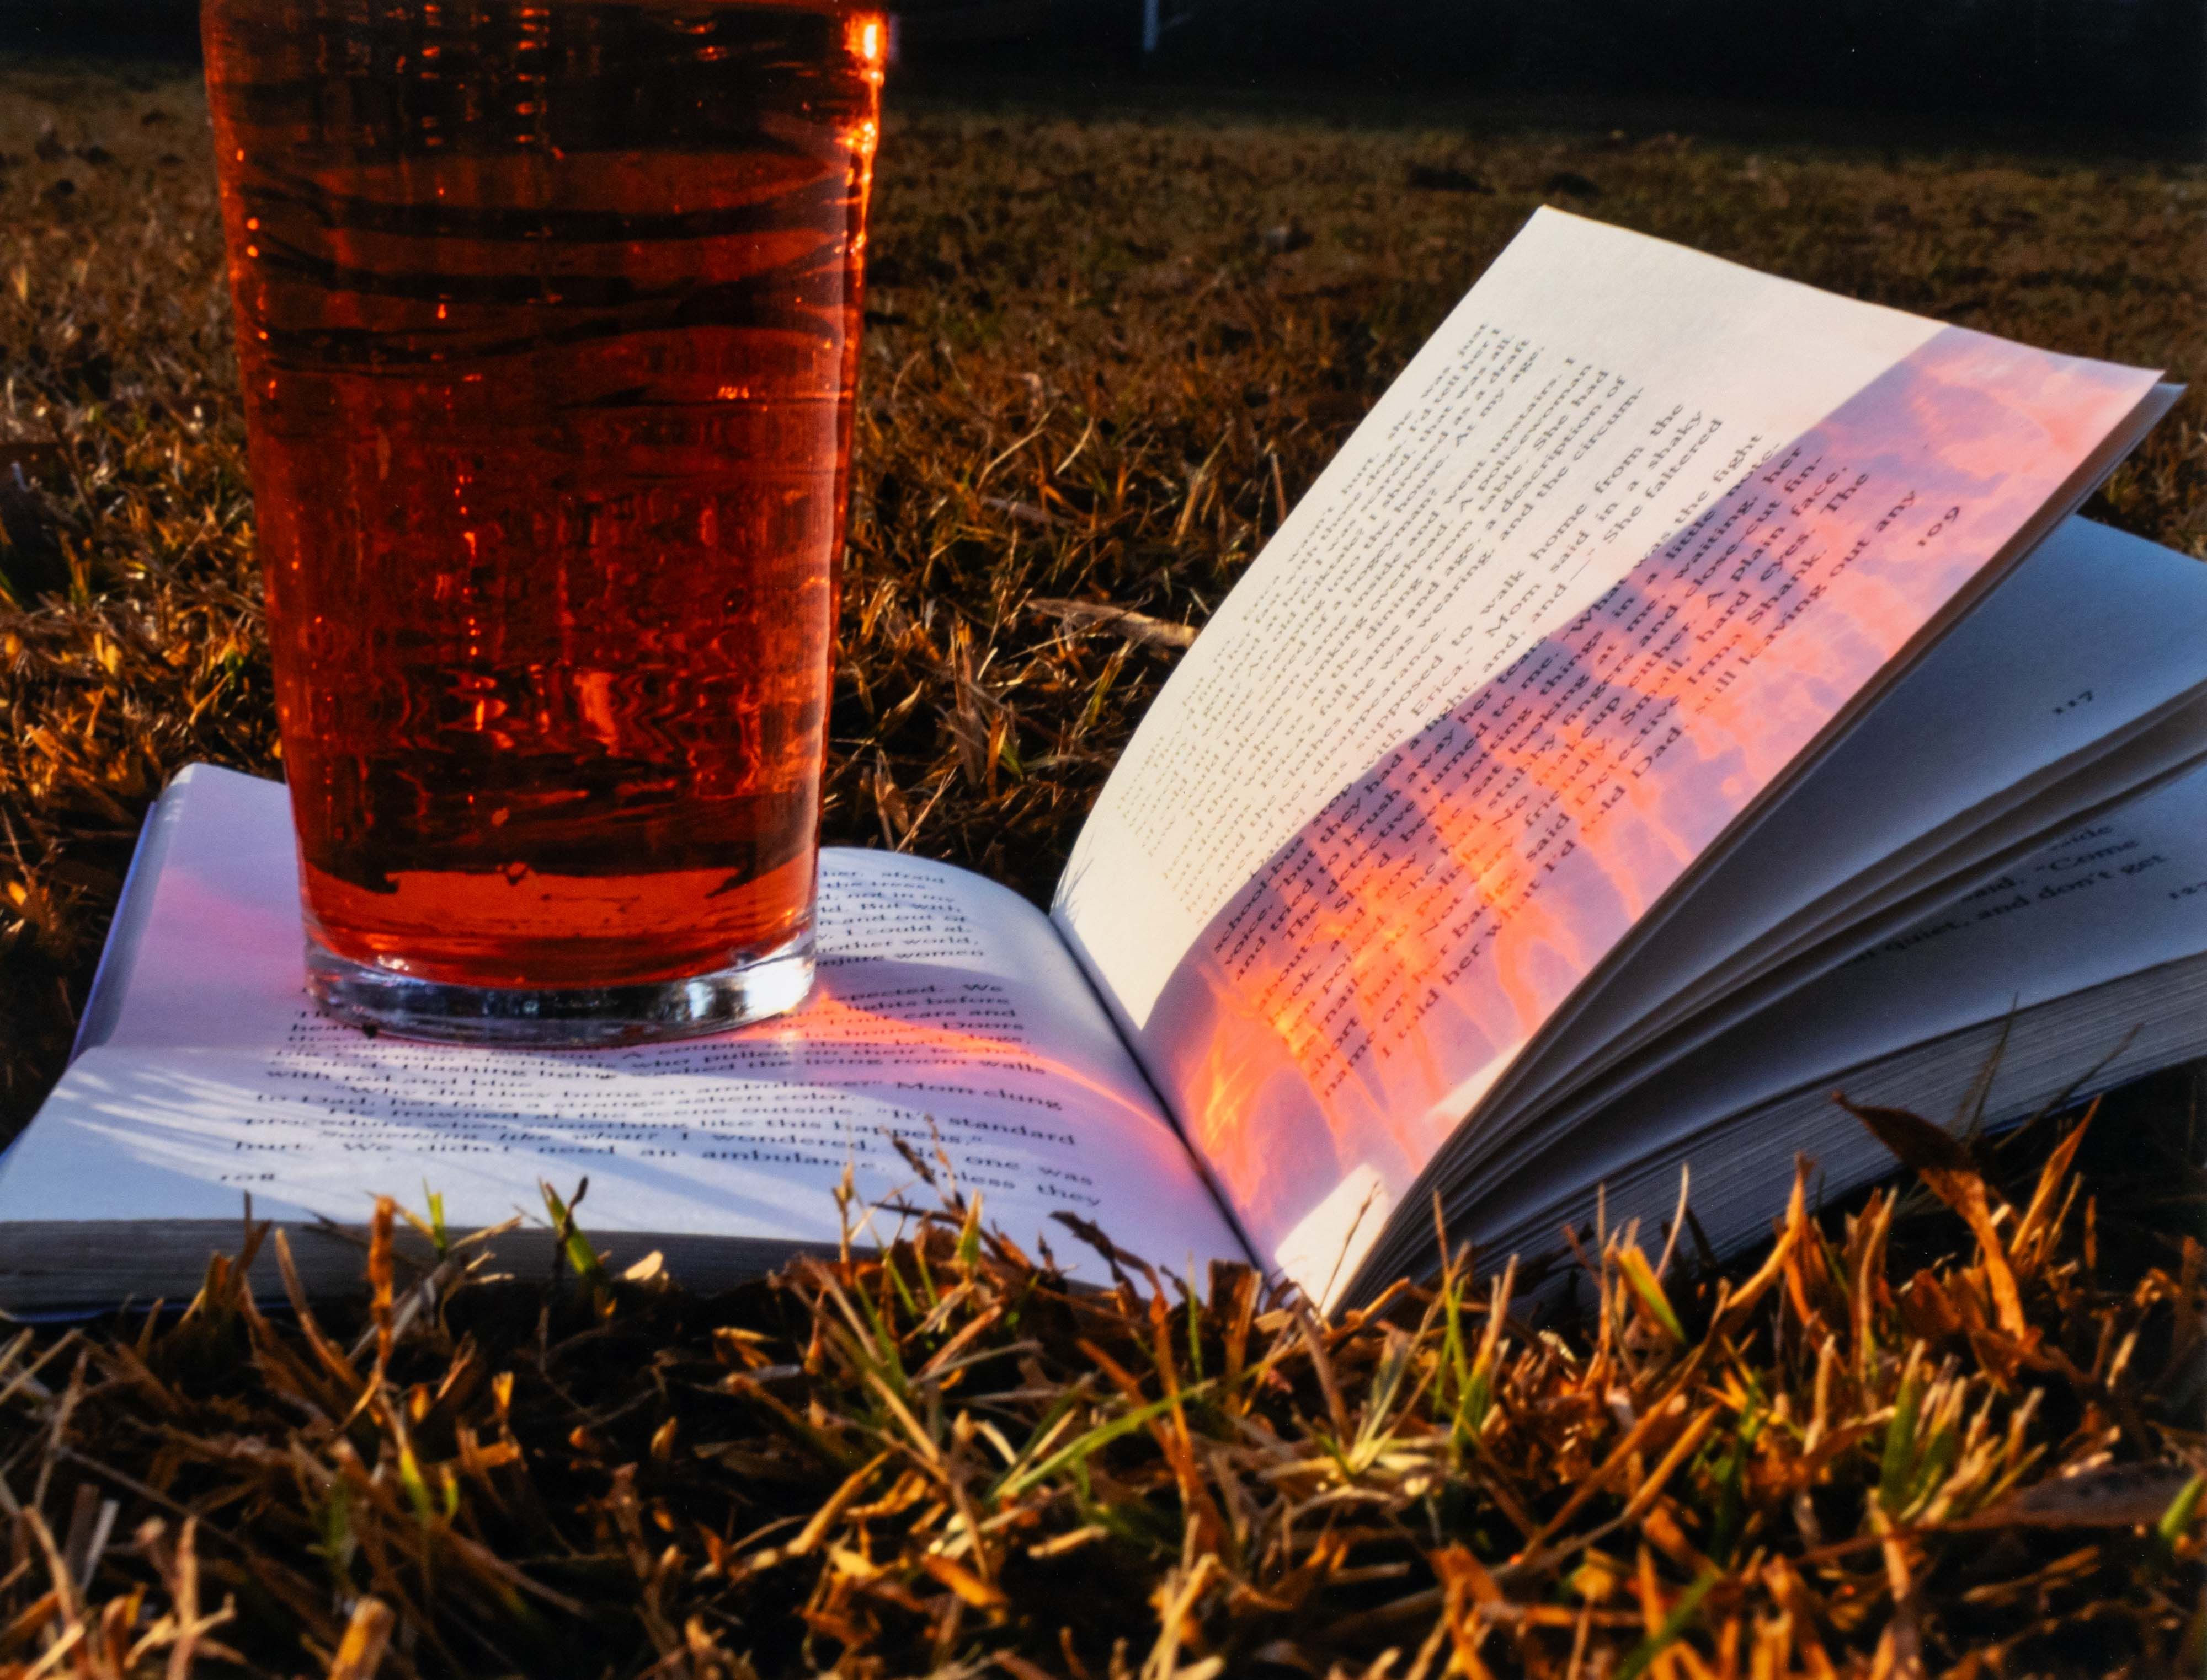
1st Place Winner
Linsey Wilson
Division 6: Photography
Southside Middle School
Florence County School District One
Teacher: Robin Voss

